Slide 1
Introduction to the WECAFC Regional Database
Yann LAURENT (yann.laurent@fao.org )

Slide 2
Plan
1. RDB background
4. The prototype
3. Building a RDB
2. Introduction to FIRMS

Slide 3
RDB Background
The background of the WECAFC Regional Database

Slide 4
Background
WECAFC 15:
Collaboration with FIRMS is agreed:
Resources and fisheries inventories as a starting point to build regional knowledge on fisheries
Minimum steps towards becoming a RFMO:
Increase and improve information content on fisheries data and statistics
Increase accuracy of data and statistics via utilizing agreed practices in data collection
Develop and implement agreed practices for data sharing
Identify feasible stock assessment models for the region

Slide 5
Background
The need for regional information and data:
Information on the resources and fisheries in the region, especially the share one for the key species (Conch, lobster, Flying fish)
Collect minimum data to support fisheries management (the Regional Fisheries Management Plans) and stock assessment : support evidence based policy making
➔ need to define the type of information to be collected and a container to publish this collected information: DCRF and RDB

Slide 6
Background
The need for regional information and data as agreed during the Regional data workshop in January 2016:
Information on the resources and fisheries in the region, especially the share one for the key species (Conch, lobster, Flying fish)
Collect minimum data to support fisheries management (the Regional Fisheries Management Plans) and stock assessment : support evidence based policy making
➔ Need to define the type of information to be collected and a container to publish this collected information: DCRF and RDB

Slide 7
Background
WECAFC Regional database:
Should be an entry point to the FIRMS inventories
Should provide tools to collate statistics from the WECAFC Members according to the DRCF
Should provide dissemination tools for the collated statistics
Should apply Data and Access Sharing Policies for any data and information (confidentiality of data)
The Regional data workshop endorsed the support from the BlueBRIDGE to develop a RDB prototype

Slide 8
FIRMS Inventories
Introduction to FIRMS Inventories

Slide 9
About the Partnership
FIRMS Inventories
14 intergovernmental organizations / 19 RFBs subscribed the Partnership Arrangement providing for international cooperation in the development and maintenance of FIRMS
Provide access to a wide range of high-quality information on the global monitoring and management of fishery marine resources.
In 2015 we celebrated “10 years of FIRMS”

Slide 10
FIRMS target audience and value proposition
FIRMS Inventories
RFBs:
to increase visibility beyond their area of competence
to provide a dissemination capacity when no other dissemination mechanism exists
to foster information exchange in context where data sharing is a sensitive issue or would require long learning curve
to be functional to needs of Fishery Management Plans
regional dashboard of indicators for the State of environment
National agencies of governments dealing with fisheries reporting
Analysts and instruments (e.g. SDG14) working on global monitoring of state of fishery resources
NGOs promoting sustainable fisheries and promoting progress in fisheries management (FIPs), including through traceability of fish products
Stakeholders (e.g. fishermen associations) and General public, to whom fishery data should be made available in more immediate and easy ways

Slide 11
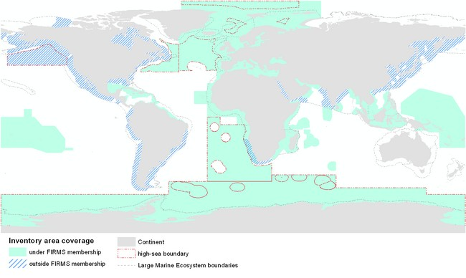
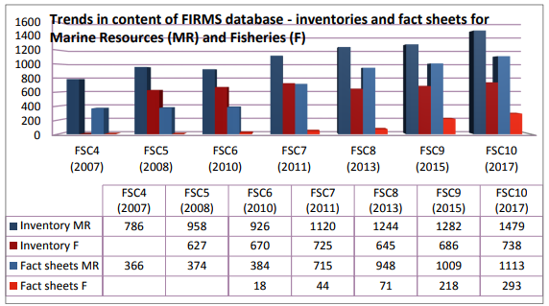
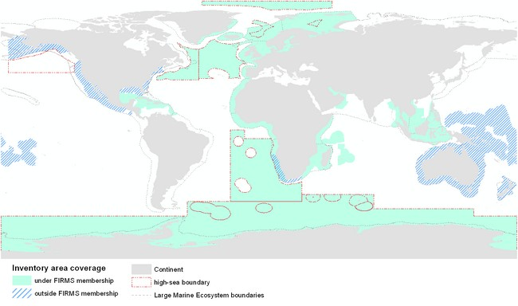
FIRMS Data coverage
FIRMS Inventories
FIRMS is reporting on Marine Resources and Fisheries
Published inventory of 1479 stocks and 738 fisheries
Published status reports for about 600 stocks and 250 fisheries
Identified records with no published status:
~ 900 stocks
~ 500 fisheries
FIRMS Marine Resources data coverage (tuna resources not included)
FIRMS Fisheries data coverage
Notes:
Source: page 4 and page 8 of FSC10 meeting doc http://www.fao.org/fi/static-media/MeetingDocuments/FIRMS/FIRMS_FSC10/2ae.pdf

Slide 12
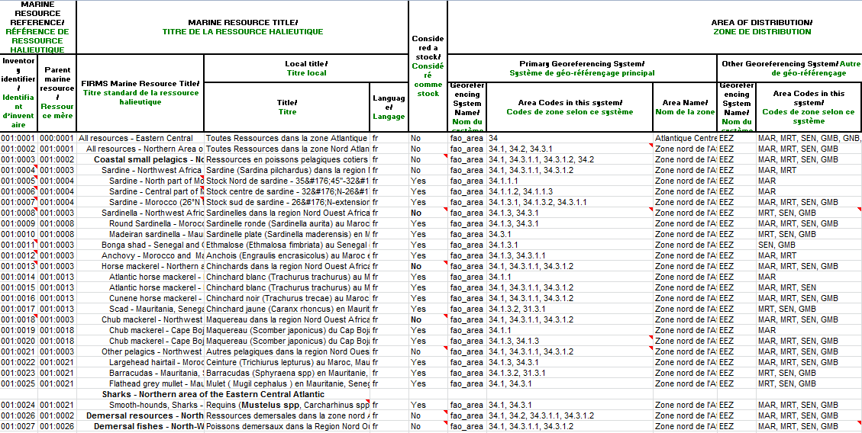
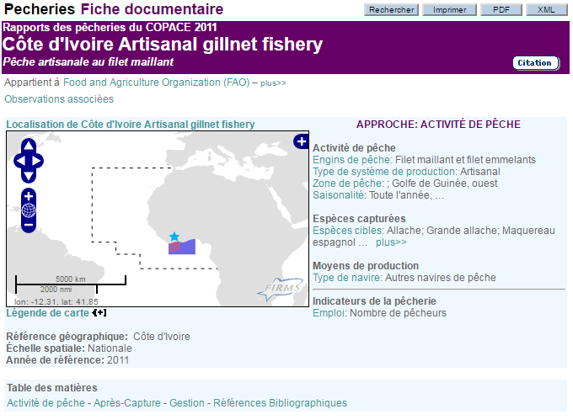
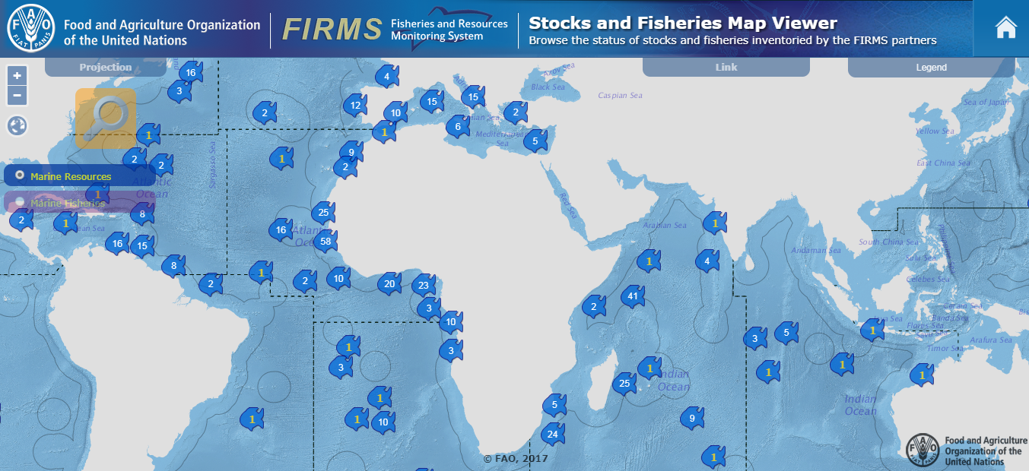
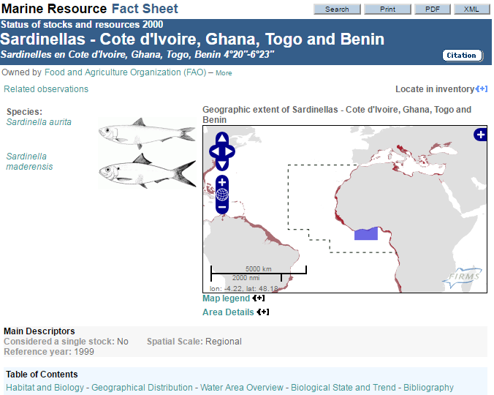
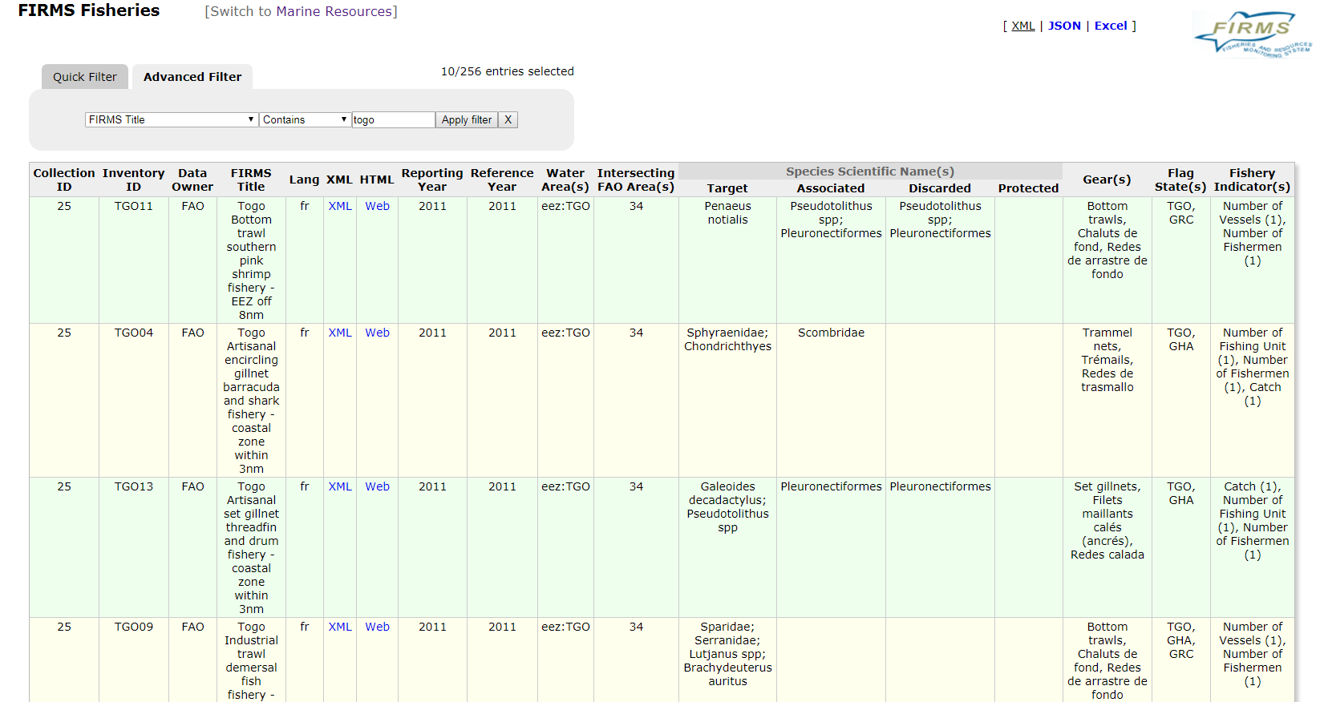
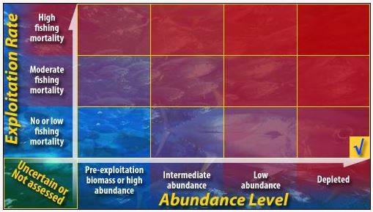
FIRMS Products
FIRMS Inventories
Marine Resource & Fishery Inventories (Excel)
Standards and guidelines
Fact Sheets
Search interfaces
Map viewer
Web services

Slide 13
FIRMS Marine Resource & Fishery inventories
FIRMS Inventories
Inventories constitute the backbone of the FIRMS knowledge base. Inventories provide the complete picture from which to assess current level of knowledge
Marine Resources and Fisheries are inventoried for reporting purpose
To capture status and trends of Marine Resources and Fisheries
The inventory is implemented using an Excel format for initial data input
Once harmonized according FIRMS standards and validated by data owners, information is stored into the FIRMS database and published as fact sheets
Through their data inputs in FIRMS, partners contribute to the global inventory of marine resources and fisheries.
“You manage what you can measure”

Slide 14
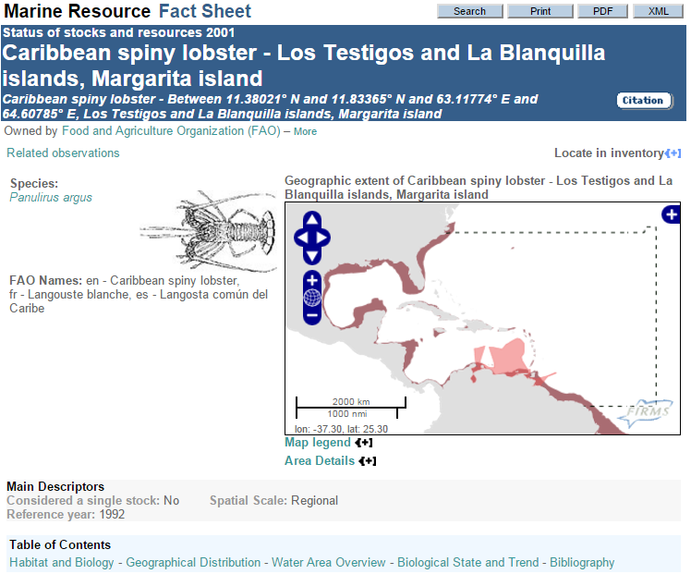
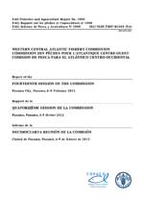
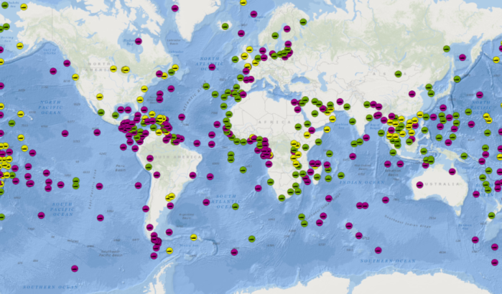
FIRMS Marine Resource & Fishery inventories
FIRMS Inventories
One input many outputs: fact sheets, maps, publications, etc.

Slide 15
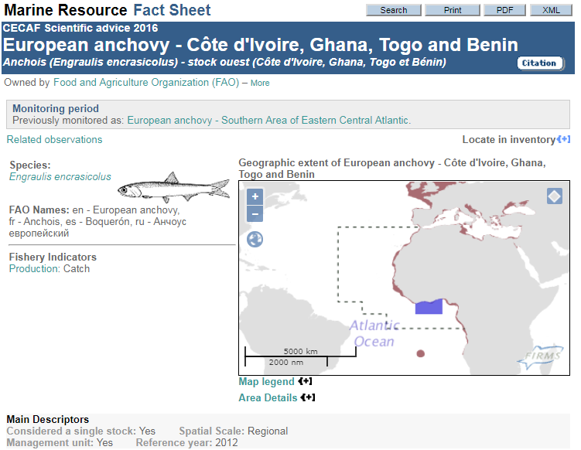
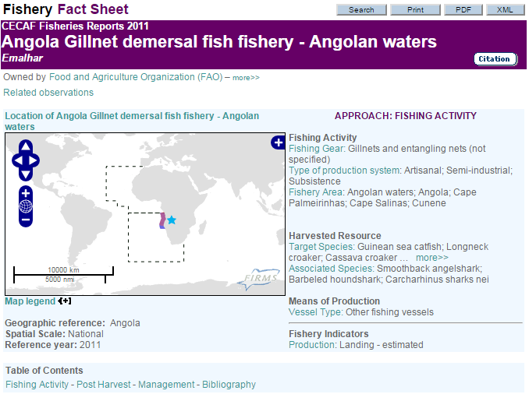
FIRMS Marine Resource & Fishery fact sheets
FIRMS Inventories
Examples of fact sheets
CCSBT - Southern Bluefin tuna IATTC - Swordfish - Northeastern Pacific NAFO - Atlantic Cod - Flemish Cap
CECAF - Angola : Gillnet demersal fish fishery - Angolan waters
SEAFO - South East Atlantic SEAFO High seas fisheries
“Data tell, stories sell”

Slide 16
FIRMS 10 years after Directions for fulfilling the next 10 years ambition
FIRMS Inventories
Minimum data requirements to facilitate reporting to FIRMS
FIRMS maps viewer, and other on-line services
Dashboard of stock status indicators for the region – traffic light approach
Global Record for Stocks and Fisheries: towards
supporting a live SDG 14.4.1 indicator “Proportion of fish stocks within biologically sustainable levels”
use of FIRMS stocks and fisheries references for traceability purpose (also contribute to support 14.6.1 “Progress by countries in the degree of implementation of international instruments aiming to combat illegal, unreported and unregulated fishing”)
Cost-effective solutions for enhancing benefits and returns on investments

Slide 17
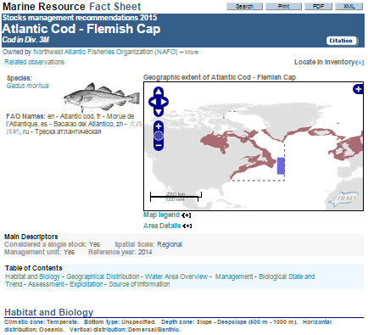
FIRMS Inventories
Towards mechanisms ensuring reporting timeliness
Mainstream the FIRMS reporting flow with Partner’s established reporting procedures

Slide 18
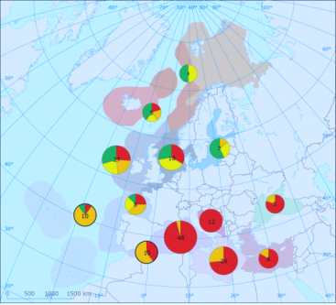
Traffic light approach
FIRMS Inventories
Traffic light approach

Slide 19
FIRMS Stocks & Fisheries Map Viewer
FIRMS Inventories
Interactive mapping application to browse the status of stocks and fisheries inventoried by the FIRMS partners

Slide 20
Global Record for Stocks and Fisheries
FIRMS Inventories
Fisheries and Resources Monitoring System (FIRMS)
RAM Legacy Stock Assessment Database
FishSource
Comprehensive and shared global reference set of
stocks and fisheries records (a component of the BlueBRIDGE project – EU Horizon 2020)

Slide 21
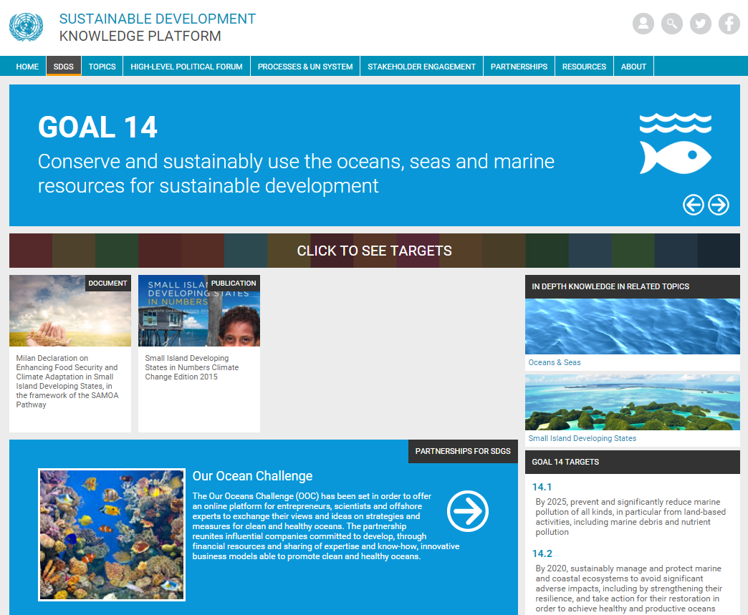
FIRMS & the Sustainable Development Goals
FIRMS Inventories
FIRMS, as a global reporting tool on fisheries and resources status & trends, is expected to be instrumental to the SDG 14 “Conserve and sustainably use the oceans, seas and marine resources for sustainable development”
“In particular can provide the RFBs’ backbone to support a live monitoring of Indicator 14.4.1 “Proportion of fish stocks within biologically sustainable levels”, for which FAO/FI is responsible
14.4 By 2020, effectively regulate harvesting and end overfishing, illegal, unreported and unregulated fishing and destructive fishing practices and implement science-based management plans, in order to restore fish stocks in the shortest time feasible, at least to levels that can produce maximum sustainable yield as determined by their biological characteristics.
Notes:
https://sustainabledevelopment.un.org/sdg14
support to Stock status monitoring

Slide 22
Key messages
FIRMS Inventories
FIRMS is a partnership of intergovernmental fisheries organizations with competence for resource assessment and conservation.
Provides decision-and others with high-quality, authoritative information on global marine fisheries resources.
Enables decisions makers with information to develop informed fisheries and marine resource policies in accordance with the Code of Conduct for Responsible Fisheries.
Information Dissemination: presented in synthesized “Fact Sheets” and “State of Resources Summaries”.
Transparency and ownership: Fact Sheets sourced with a partner’s relevant links, providing transparent traceability, and when validated by the partner, they may also include related references and observations from other sources.

Slide 23
Key messages
FIRMS as a mature framework for global reporting tool on fisheries and resources status & trends
FIRMS as a shared reporting & web-dissemination system
as well as a data collation & sharing mechanism
FIRMS contribute to evidence-based decision making

Slide 24
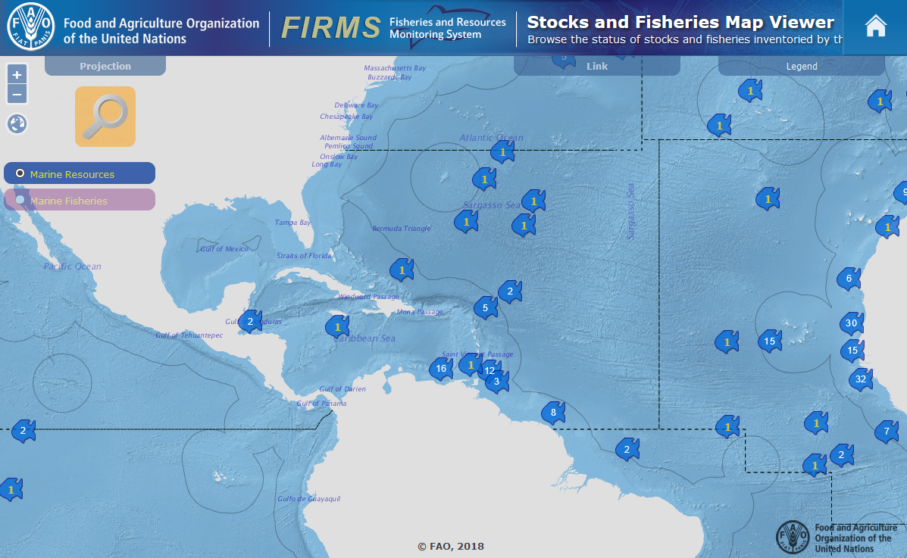
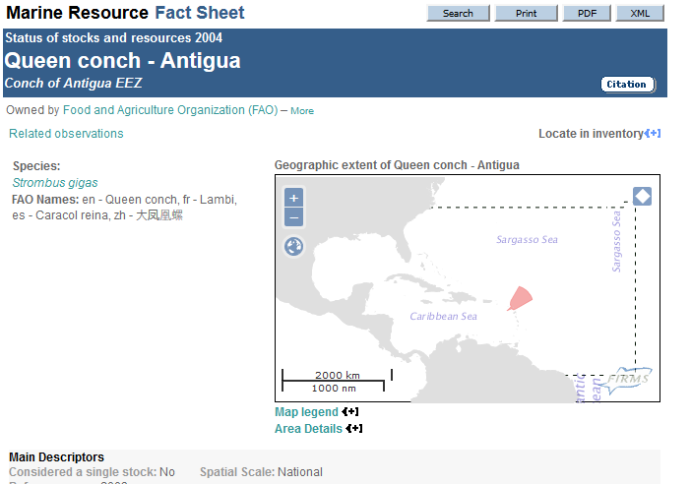
Assessment of Resource in the WECAF area
FIRMS Inventories
During the WECAFC-FIRMS phase I project: focus on the conch, lobster and flyingfish inventories: 22 Fishery fact sheets published from 7 countries and 6 marine resources
Notes:
80 fisheries: Angola, Côte d`Ivoire, Gabon, Guinée, Senegal, Spain, and Togo

Slide 25
Assessment of Resource in the WECAF area
FIRMS Inventories
WECAFC-FIRMS phase I project lesson learnt:
Importance of support from sub-regional and regional organizations (WECAFC, CRFM, OSPESCA) to build this inventories
Need to extend to other species of interest in the region with synergies with other projects: Shrimp and groundfish, large pelagics (including billfish),
Need for FIRMS focal points in each country
Notes:
80 fisheries: Angola, Côte d`Ivoire, Gabon, Guinée, Senegal, Spain, and Togo

Slide 26
Building a RDB
Building a WECAFC regional database

Slide 27
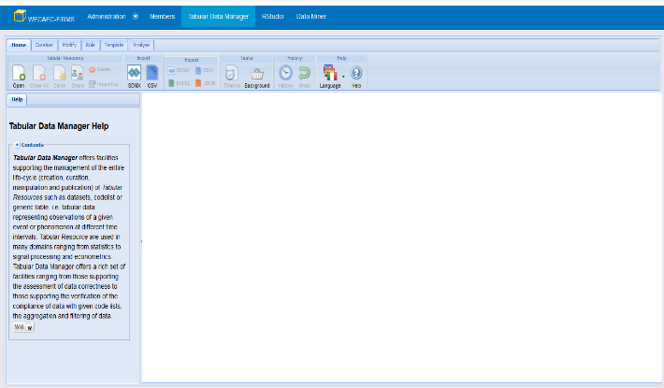
Building a RDB
Development of the WECAFC Regional database:
The definition of minimum data requirements for reporting: Data collection Reference Framework DCRF
A series of tools developed under the BlueBRIDGE project (EU funded) to support reporting:
A simple tool for the regional data manager
to create data calls based on the DCRF
A userfriendly tool based on Excel to help the national data manager to comply with the reporting request (WECAFC being a RFB, it is not yet an obligation!)

Slide 28
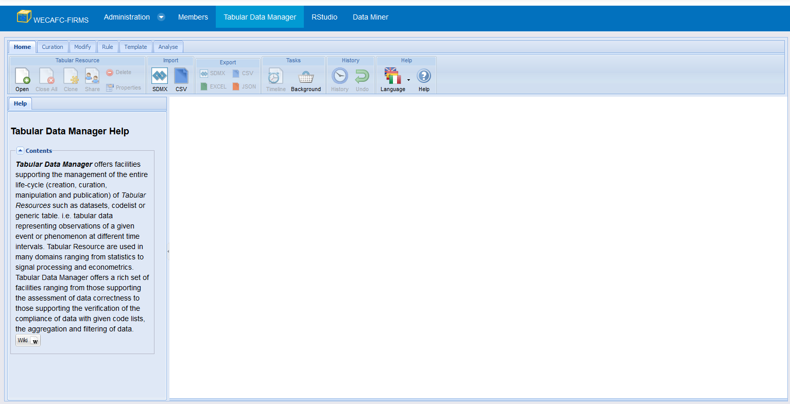
Building a RDB
Simplifying reporting to regional organization
WECAFC Regional database: Regional Data Manager
iMarine Tabular Data Manager

Slide 29
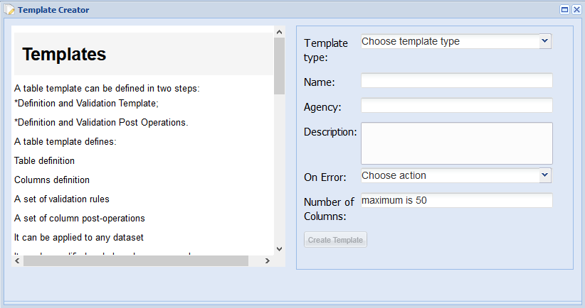
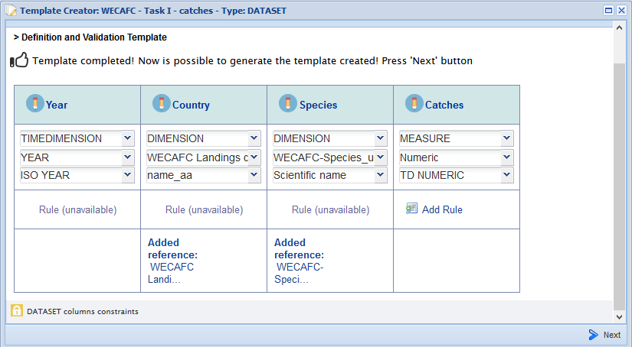
Building a RDB
Simplifying reporting to regional organization
WECAFC Regional database: Regional Data Manager
iMarine Tabular Data Manager
Template creation
A DSD is created

Slide 30
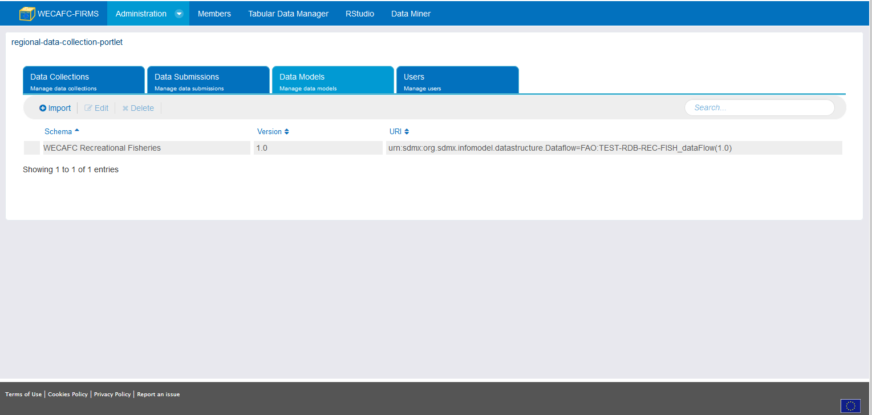
Building a RDB
Simplifying reporting to regional organization
WECAFC Regional database: Regional Data Manager
iMarine Regional database administration
Creation of data calls
Based on the DSD
Importing the DSD
Creating the collection (data call)
Ready to be used by the national data manager

Slide 31
Building a RDB
Simplifying reporting to regional organization
WECAFC Regional database: National Data Manager
Install an iMarine plugin in Excel
Validation services (web services; no macro)

Slide 32
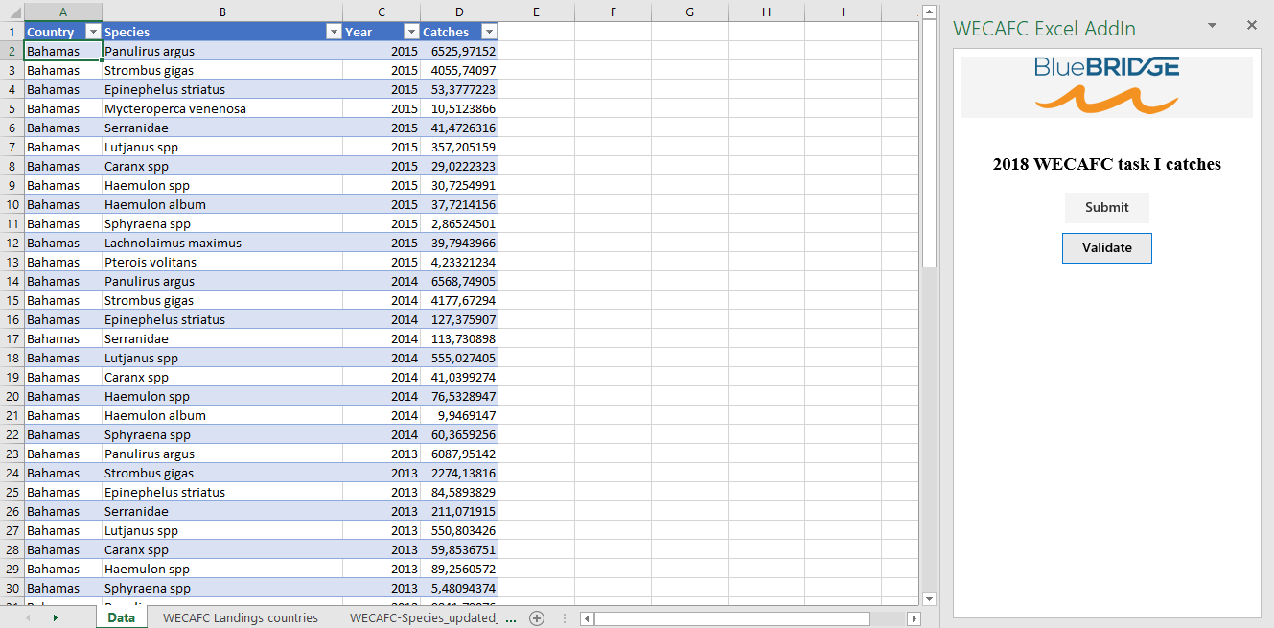
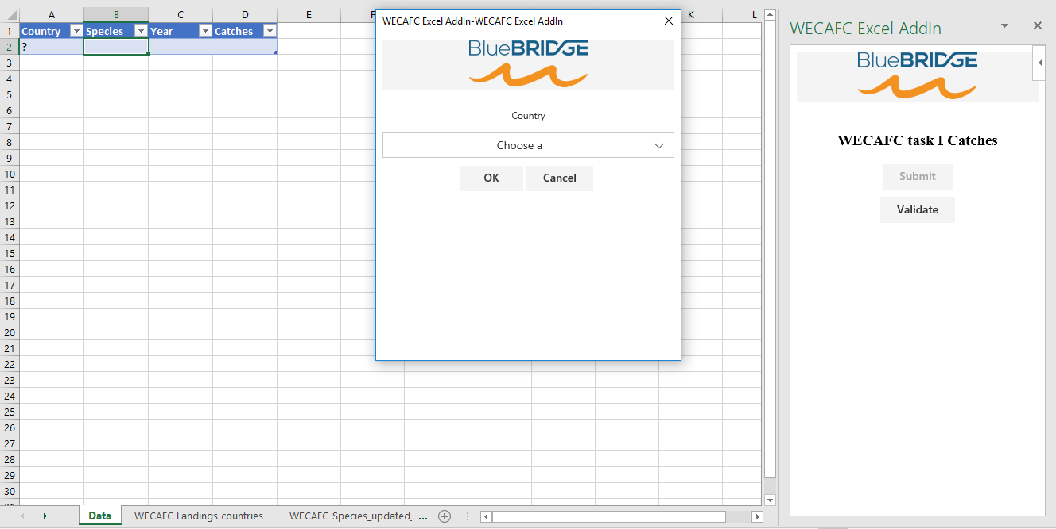
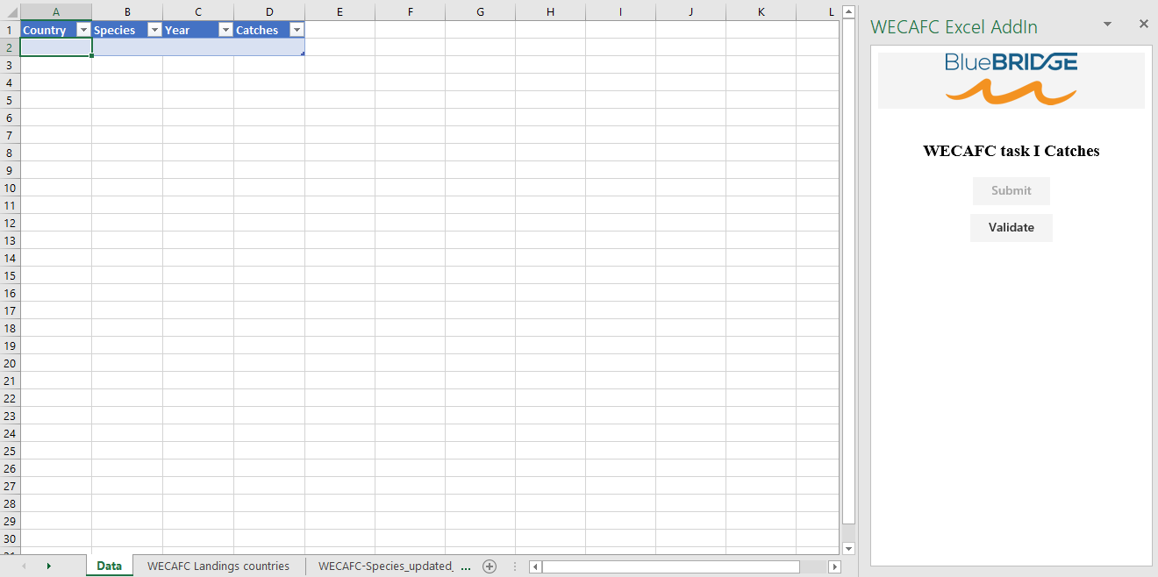
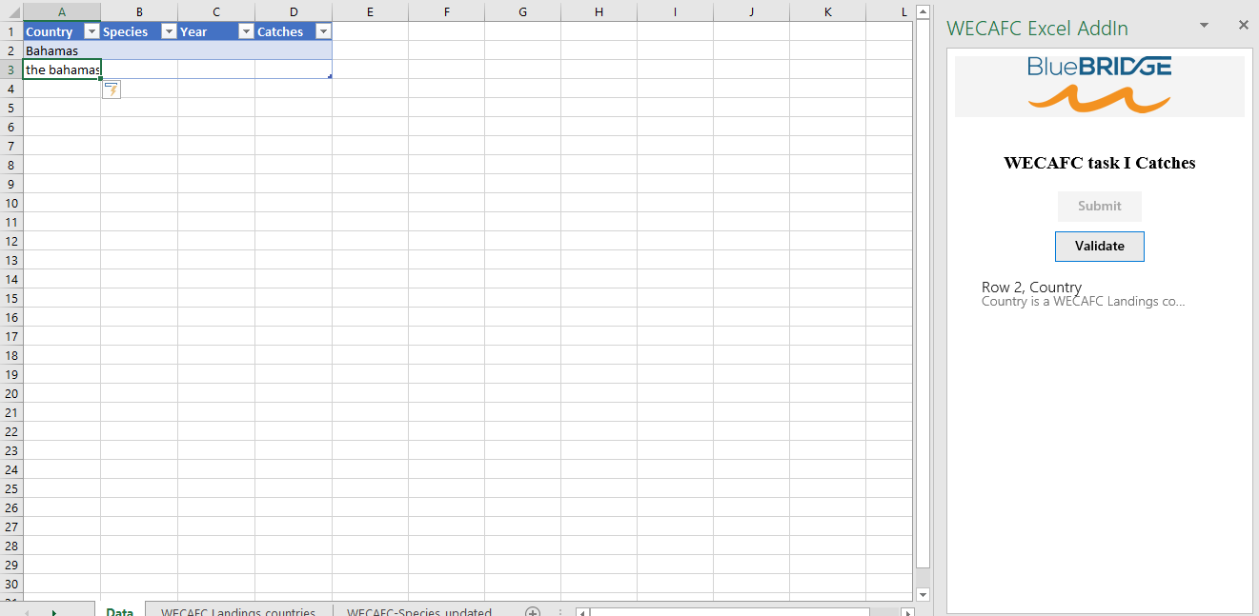
Building a RDB
Simplifying reporting to regional organization
WECAFC Regional database: National Data Manager
Will use his Excel to fill out the form
Ready for submission !

Slide 33
Building a RDB
Simplifying reporting to regional organization
WECAFC Regional database: Back to Regional Data Manager
iMarine Regional database administration
Review of submitted data and final validation

Slide 34
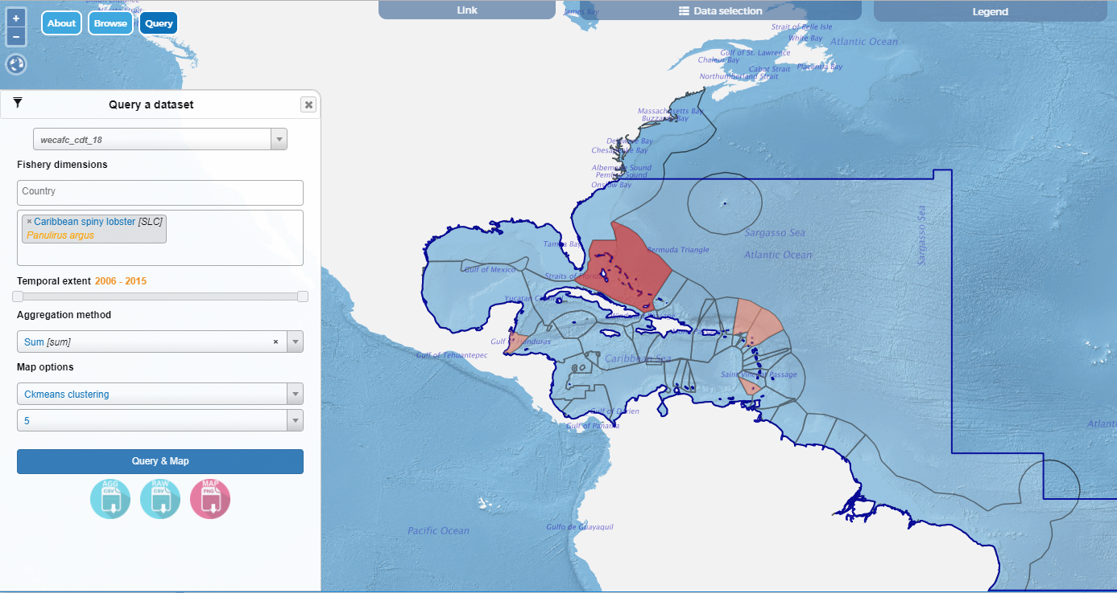
Building a RDB
Simplifying reporting to regional organization
WECAFC Regional database: A data viewer and query
Only possible if WECAFC data and metadata are harmonized and standardized !

Slide 35
Building a RDB
The prototype: live demo

Slide 36
Building a RDB
https://i-marine.d4science.org/group/wecafc-firms/wecafc-firms

Slide 37
Thank you for your attention

