Slide 1
A web-application to understand ecologically important seafloor features in Marine Protected Areas
Miles Macmillan-Lawler, Levi Westerveld, Debhasish Bhakta
GRID-Arendal
Partners: FAO, GRID-Arendal, CNR, CLS, Engineering

Slide 2
Outline
Introduction to the BlueBRIDGE Project
Need for the Protected Area Impact Maps VRE
Technical Details
User Interface
Conclusions and Next Steps

Slide 3
What is BlueBRIDGE?
BlueBRIDGE provides tailor-made data management services to support research, public/private sector and education
14 different partners delivering solutions for Aquaculture, Education, Ecosystem Approach to Fisheries, and Maritime Spatial Planning
Funded by Horizon 2020

Slide 4
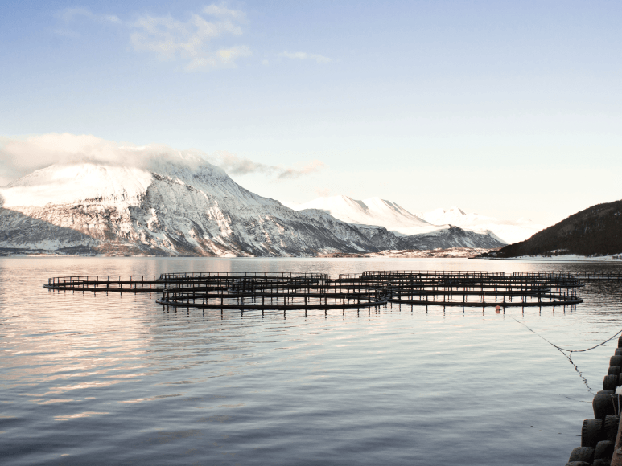
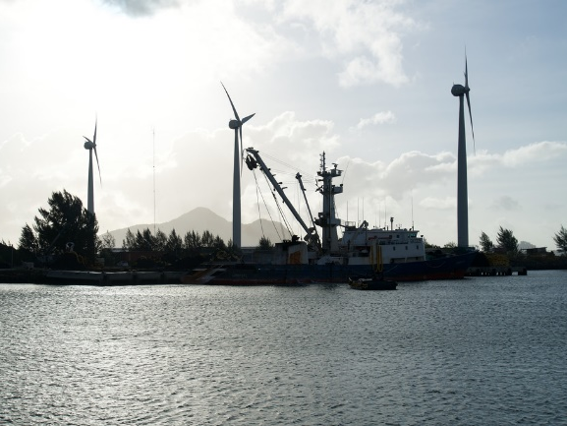
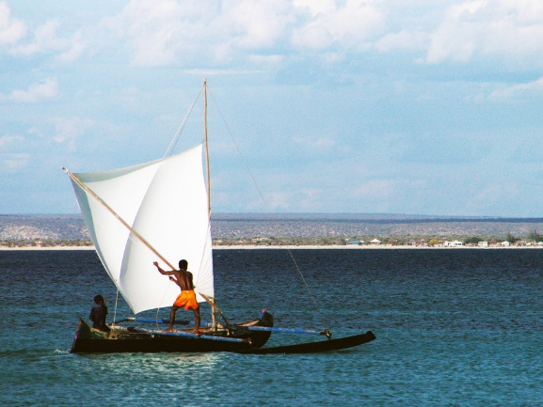
Many Uses of Maritime space
Maritime Spatial Planning
Competition for maritime space – for renewable energy equipment, aquaculture and other growth areas – has highlighted the need for efficient management, to avoid potential conflict and create synergies between different activities
EU Maritime Spatial Planning
Notes:
EU Maritime Spatial Planning Directive

Slide 5
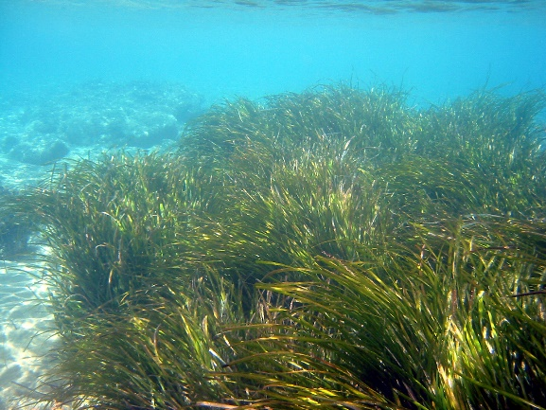
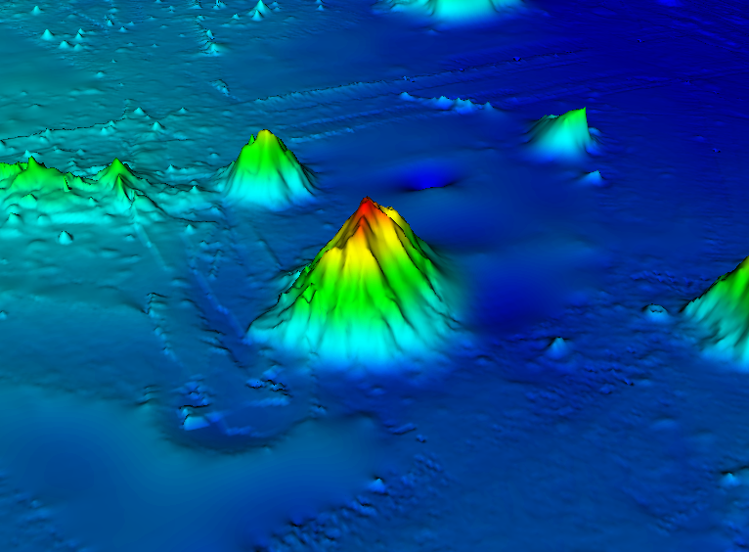
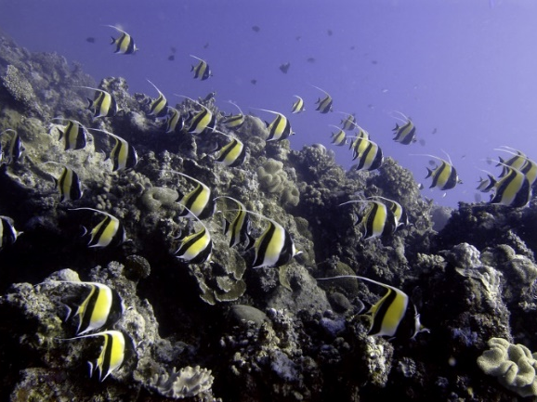
What about the Environment?
Convention on Biological Diversity - Aichi Target 11
By 2020 […] 10 per cent of coastal and marine areas, especially areas of particular importance for biodiversity and ecosystem services, are protected […]
CBD Aichi target 11
Notes:
CBD has 196 parties – 195 states and EU

Slide 6
Marine Protected Areas
Tool to manage human activities
How well are they protecting areas of particular importance for biodiversity and ecosystem services?

Slide 7
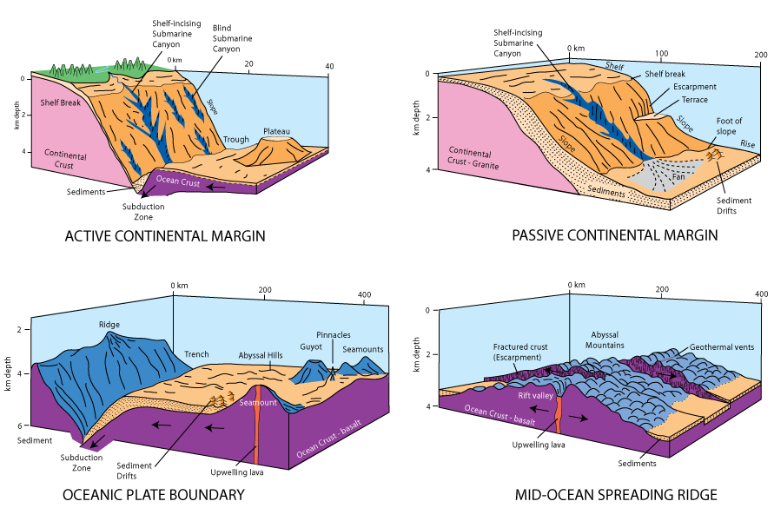
Areas important for biodiversity and ecosystem services
Focus on seafloor features available at the global scale

Slide 8
Seafloor Geomorphology

Slide 9
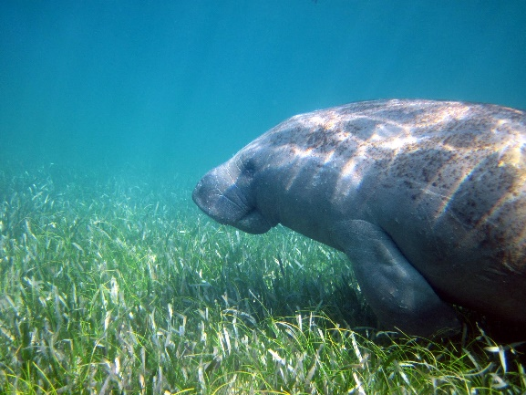
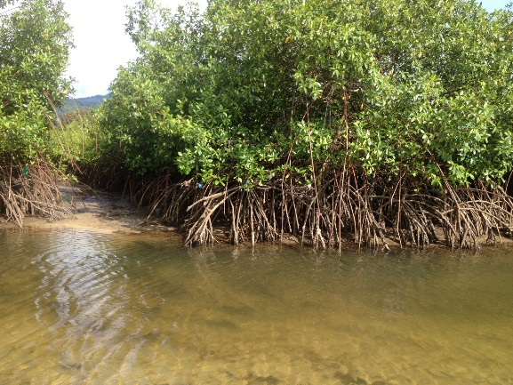
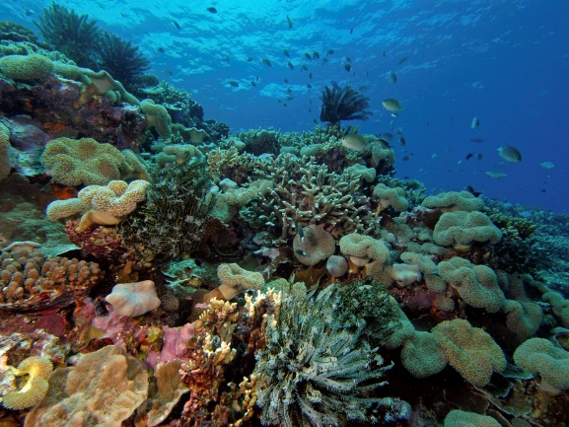
Coastal ecosystems
Seagrass, Mangroves and Coral Reefs

Slide 10
Seagrass, Mangroves and Coral Reefs

Slide 11
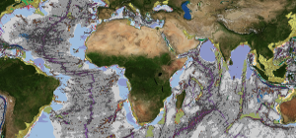
The challenge
Develop tools to assess features in marine managed areas (e.g. MPAs)
Targeted at maritime spatial planners, marine protected area managers, and researchers

Slide 12
Technical Details

Slide 13
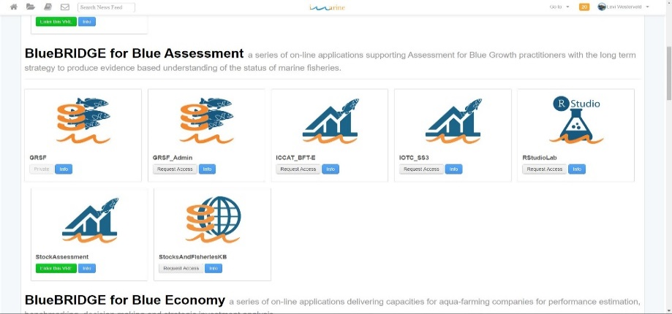
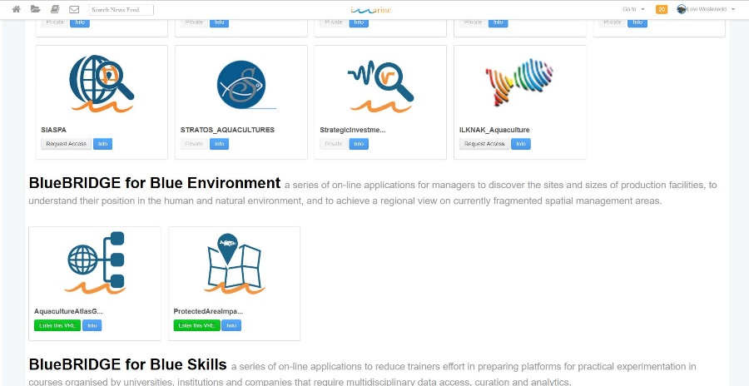
What is a Virtual Research Environment (VRE) ?
VRE stands for Virtual Research Environment. A Virtual Research Environment is a system that provides researchers and any other type of user with a web-based set of facilities including services, data, and computational facilities.
The facilities provided by a VRE are tailored to serve the needs of a specific Community of Practice. The term Community of Practice refers to a set of individuals who connect to solve a specific problem.
Learn more about VREs here and access a list of all the BlueBRIDGE VREs here.
D4Science.org is an organisation offering a
Virtual Research Environments (e.g. PAIM VRE)
Hybrid Data Infrastructure

Slide 14
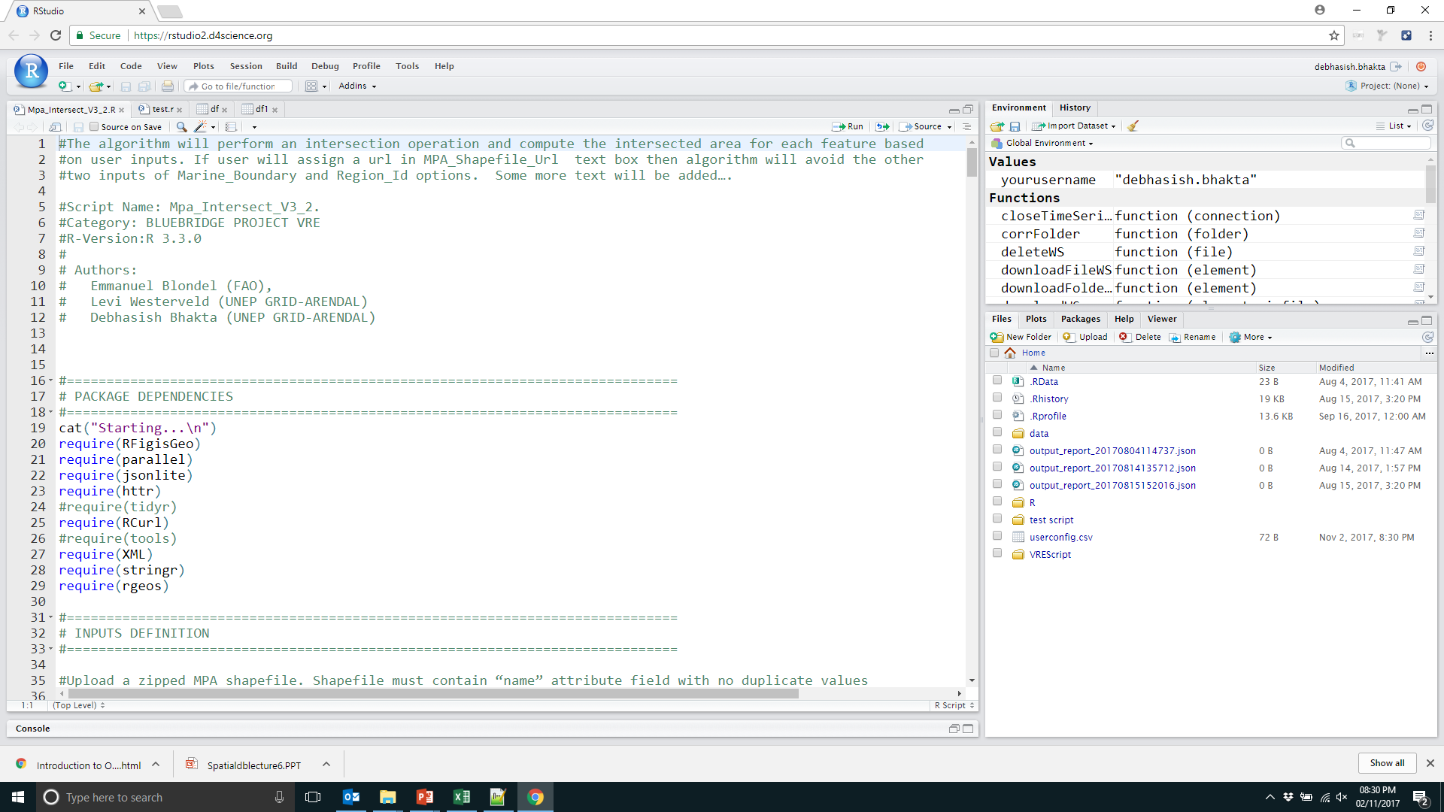
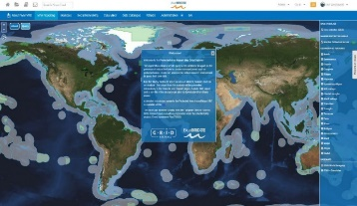
What is the Protected Area Impacts Maps VRE?
The Protected Area Impact Maps Virtual Research Environment (PAIM VRE) is a VRE developed by GRID-Arendal and FAO of UN to improve the understanding of the spatial distribution of marine protected areas (MPAs) and important seafloor features.
PAIM provides the user with tools to visualize, analyze and report on a range of ecologically important seafloor features within MPAs - a key component of Maritime Spatial Planning (MSP).
A beta version of the PAIM VRE was released on November 8th. It is open and can be accessed at this link.
Dataset
Geomorphic Feature

Slide 15
What are the dataset ?
Sl No | Layers | Type | Total
1 | Abyss | Sea floor Geomorphic Layers | 21
2 | Bridges
3 | Canyons
4 | Escarpments
5 | Glacial Troughs
6 | Guyots
7 | Hadal
8 | Reefs
9 | Ridges
10 | Rift valleys
11 | Rises
12 | Seamounts
13 | Shelf
14 | Shelf valleys
15 | Slope
16 | Terraces
17 | Trenches
18 | Troughs
19 | Fans
20 | Plateaus
21 | Spreading Ridges
22 | Mangroves | Vegetation | 2
23 | Seagrass
24 | Marine protected area (MPA) | Boundary | 2
25 | Ecoregions
26 | Exclusive economic zone
27 | Intersected mpa_EEZ | Derived layer | 2
28 | Intersect_mpa_ecoregions
29 | ESRI Imagery World | WMS Basemap | 2
30 | ESRI StreetMap World
Global extent Dataset-27 Total
Store as geospatial polygon
GCS Projection(EPGS:4326)

Slide 16
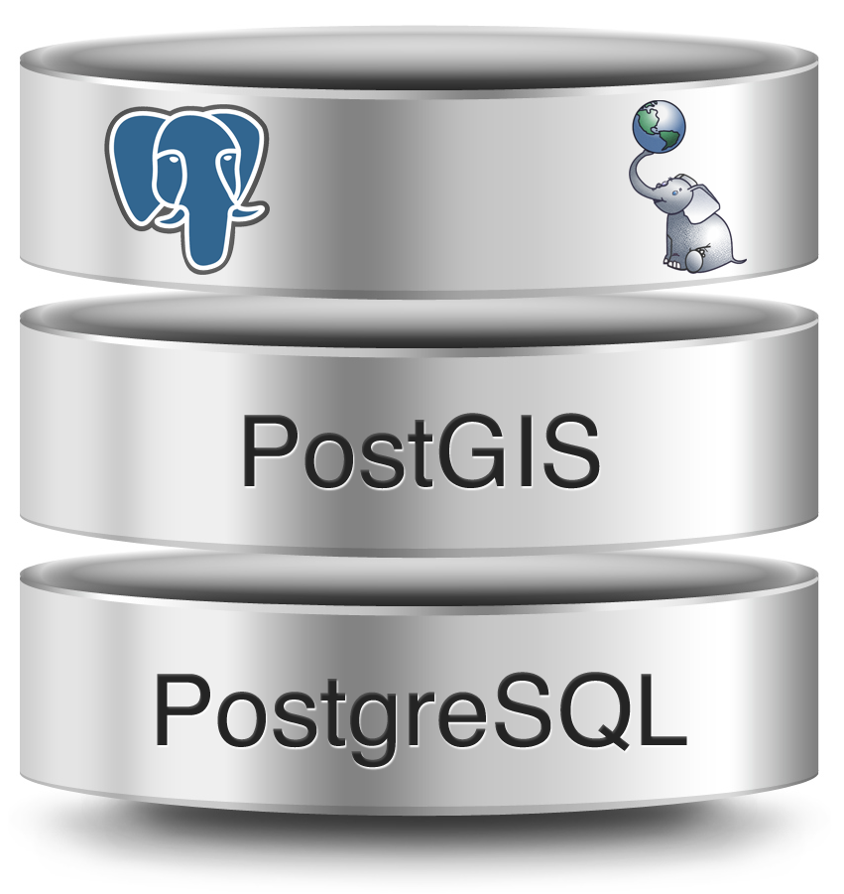
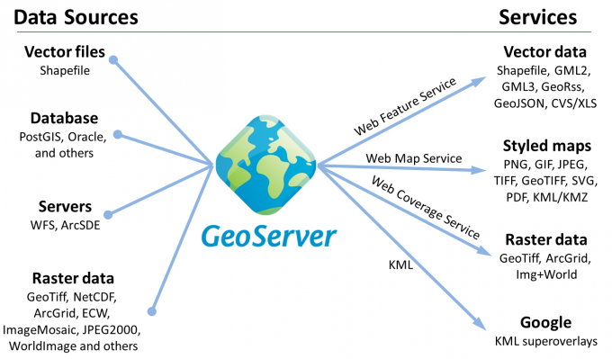
How data is store in VRE?
PostgreSQL scalable and powerful RDBMS platform
PostGIS extension enable a PostgreSQL to store geospatial data
GeoServer is a map server which enable the user
Discovery services
View services
Download services
Transformation services

Slide 17
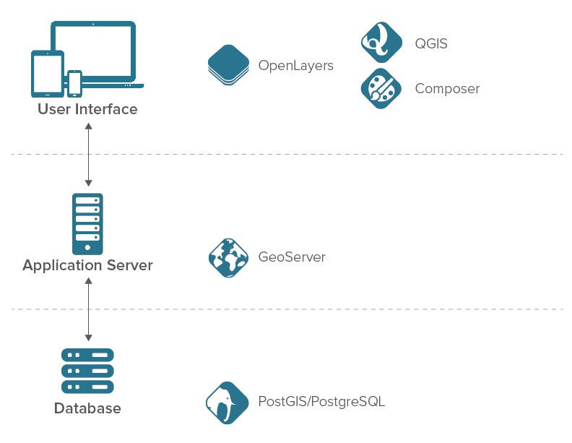
Data access/flow in VRE
In VRE Web services are consume in
Web application,
R-Studio and
Data Miner
WMS/WFS

Slide 18
How Algorithm is developed in PAIM VRE?
Step-I, II, III

Slide 19
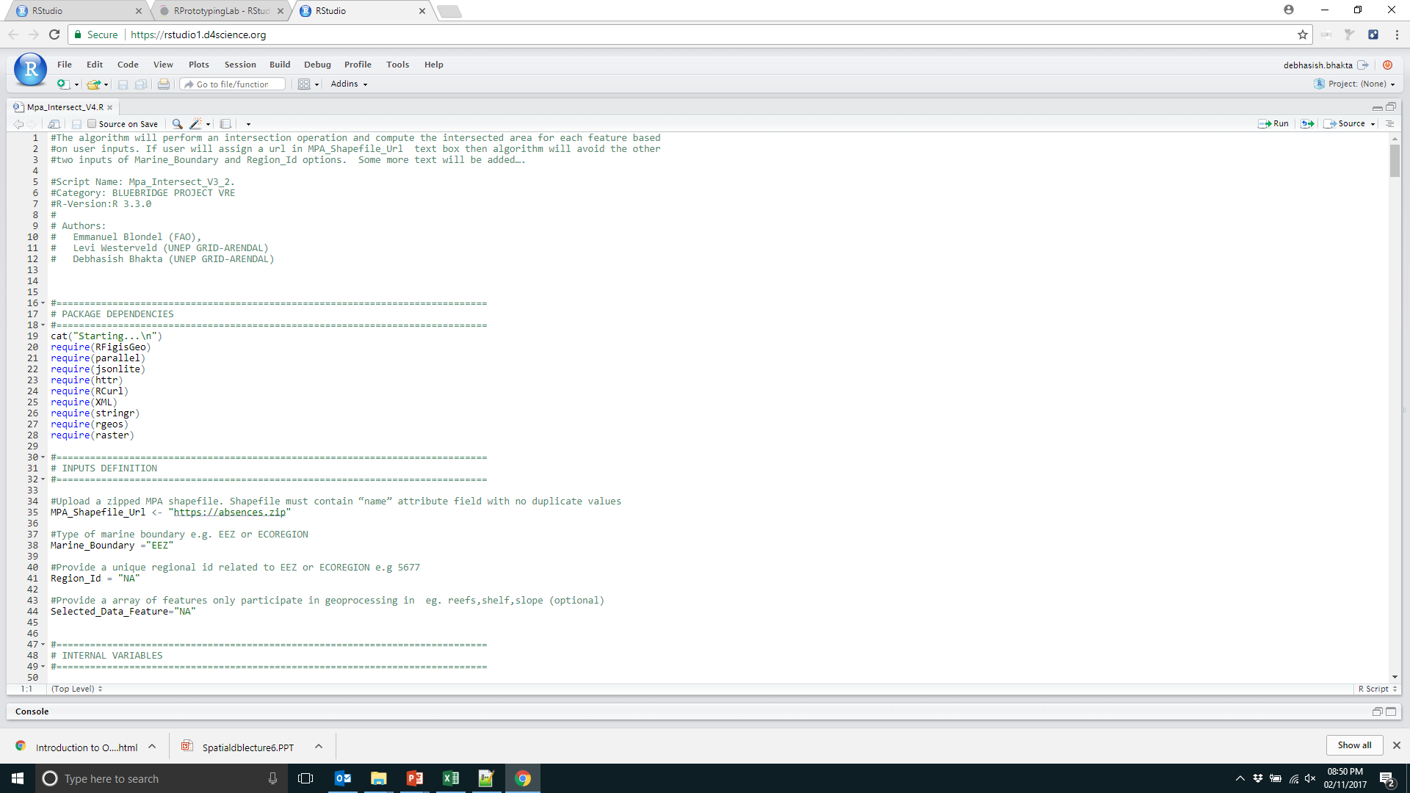
Algorithm Development Step-I
R is well known as a powerful, extensible and relatively fast statistical programming language and open software project with a command line interface (CLI).
What is less well known is that R also has cutting edge spatial packages that allow it to behave as a fully featured Geographical Information System in the full sense of the word.
RprototypeLab enable user for developing and testing the algorithm
Logic Building
More detail: https://support.rstudio.com/

Slide 20
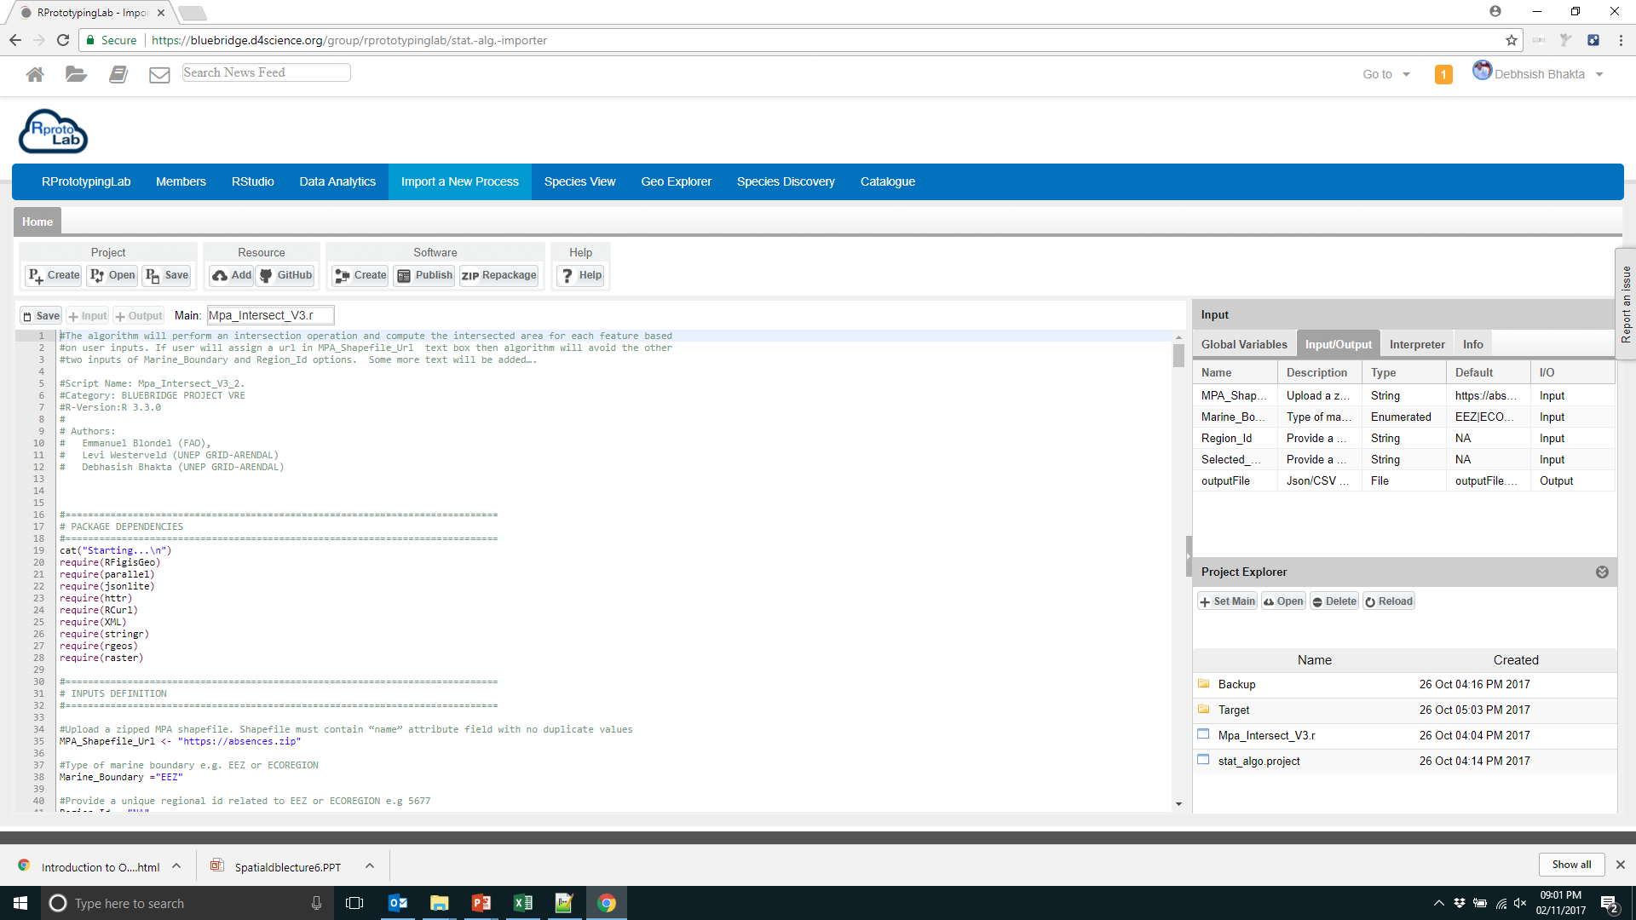
Algorithm Development Step-II
Statistical Algorithms Importer (SAI) is a tool to import algorithms in the D4Science e-Infrastructure.
In order to transform an algorithm, three main passages are required:
Define Input,
Output and types
Create the Software
Publish the Software
Repackage for further deployment
Publish Algorithm
More detail: https://wiki.gcube-system.org/gcube/Statistical_Algorithms_Importer

Slide 21
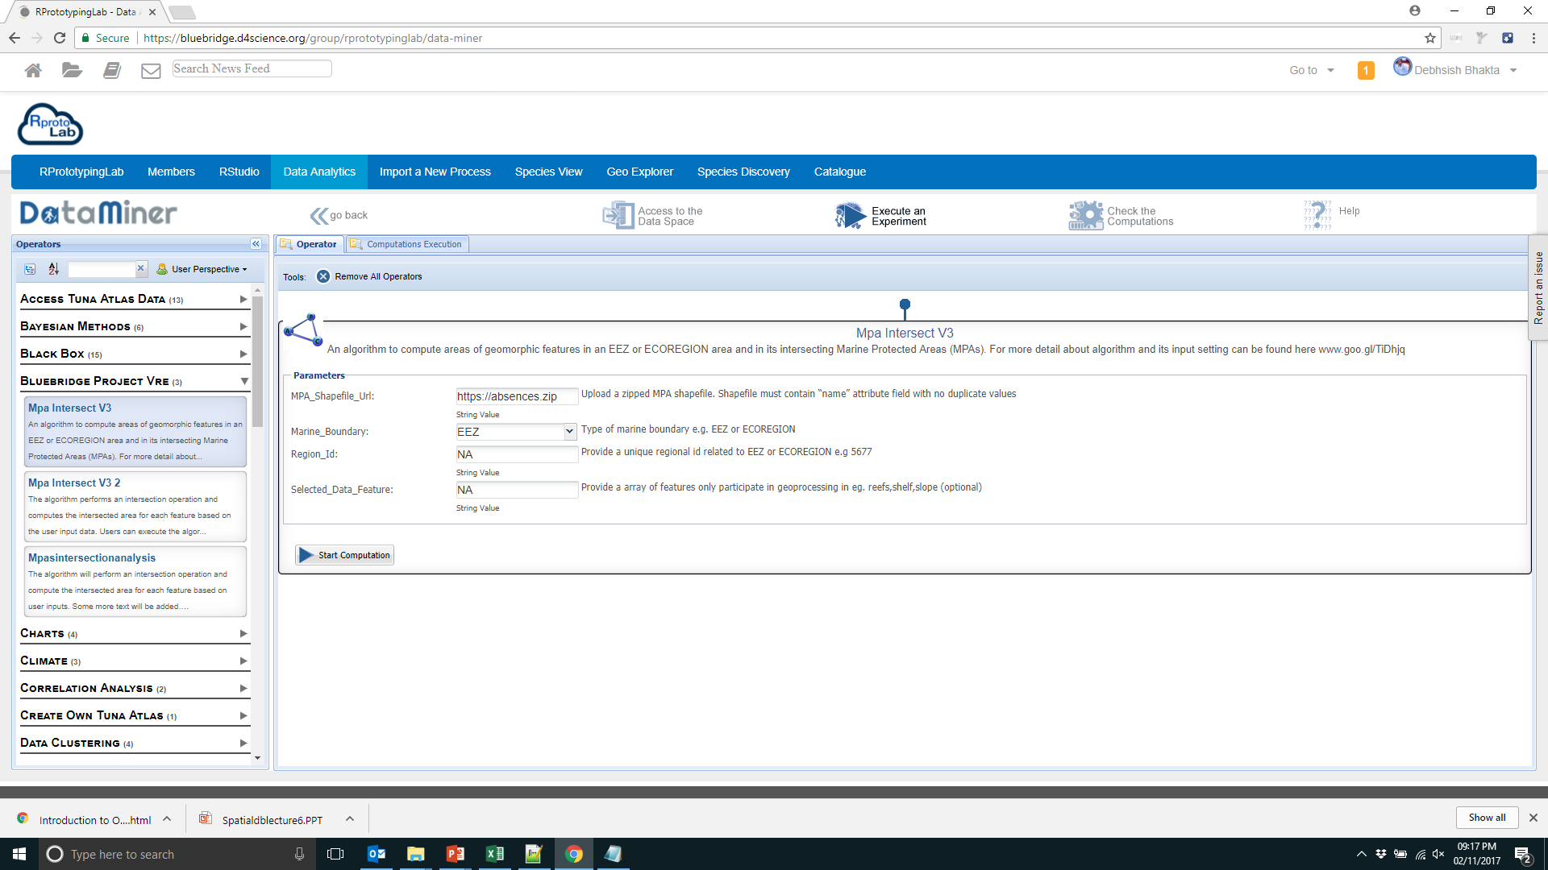
Algorithm Development Step-III
Access the Algorithm
User has to click on “Execute an Experiment” in order to access the algorithm
Algorithm is consume at Clint application by a WPS service

Slide 22
Current Algorithm in PAIM VRE
Current Algorithm specification:
Computation at powerful cloud cluster
Parallel programming approach
Data fetch from load balance GeoServer
Output json format for web access
How to set the input variable:
www.goo.gl/TiDhjq
Algorithm is public domain GitHub:
https://github.com/grid-arendal

Slide 23
Algorithm Output
French Exclusive Economic Zone
Marine Boundary: EEZ
Regional ID: 5677
Selected Feature: shelf, slope, reefs
1507401669713_output_report_20171007204109 .json
File Name
2017/10/07-20:41:10
File Format
218 MPA’s
Intersection Effective MPA Vs Each Feature
Intersection EEZ Vs Each Feature
Intersection Each MPA Vs Each Feature
+
+

Slide 24
Overall Process in Nutshell
Shapefile Url
Marine Boundary
Web Application
User Input
Regional ID
Selected Feature
Data Miner
WMS Request
Dataset
Geomorphic Feature
Web Services
WFS Request
PACKAGE DEPENDENCIES
INPUTS DEFINITION & INTERNAL VARIABLES
BUSINESS FUNCTIONS
BUSINESS ALGORITHM
OUTPUT DEFINITION
R- Algorithm
GML Data Format
WPS Request

Slide 25
User Interface

Slide 26
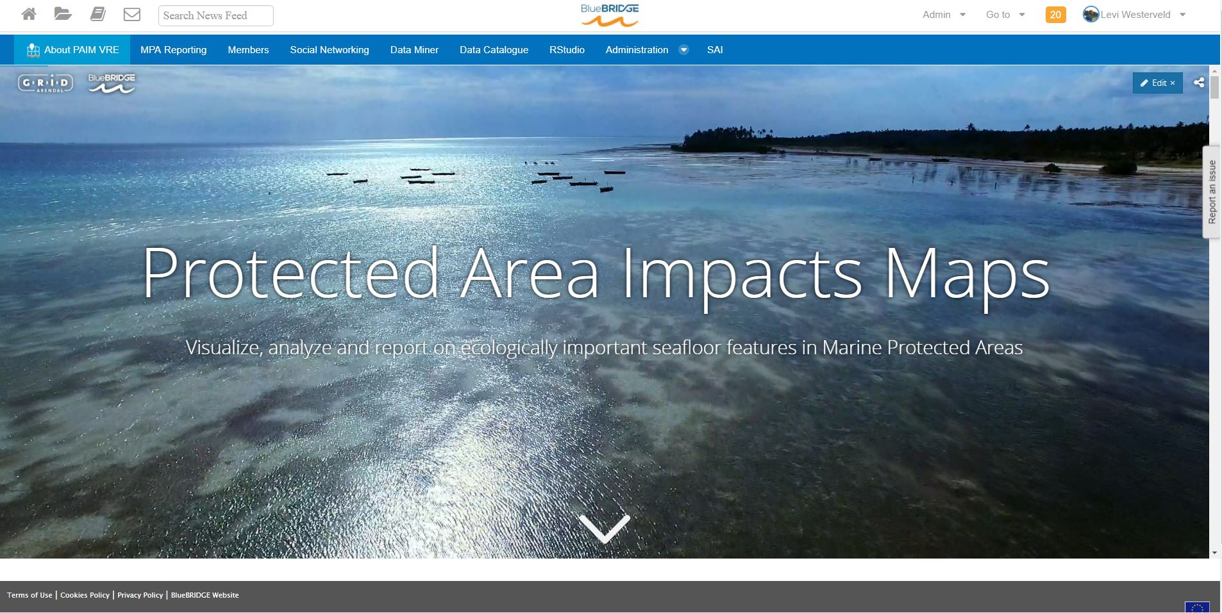
What does PAIM look like?

Slide 27
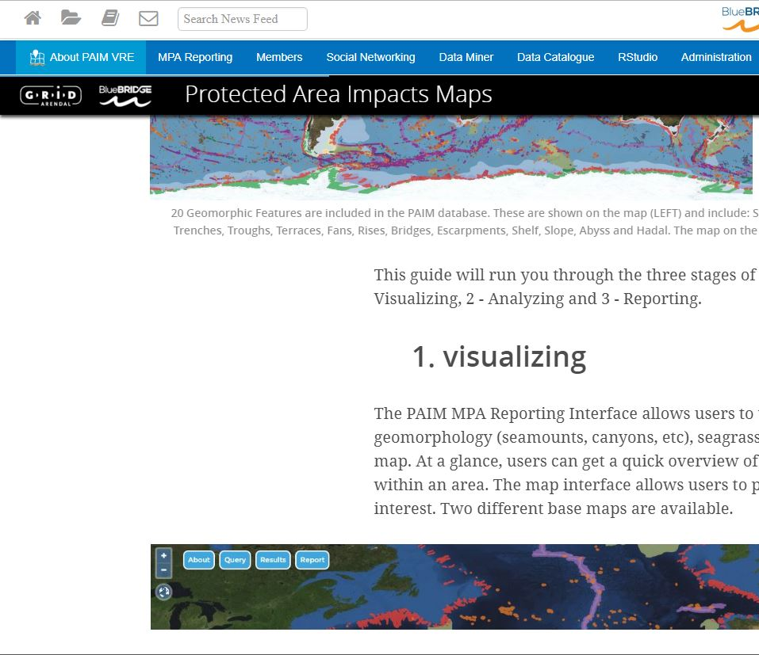
What is the ‘About PAIM VRE’ portlet?
An interactive guide with text, photos, videos and maps that outline (1) how to use the PAIM VRE; (2) what data and algorithms are used by the PAIM VRE; (3) what outputs and benefits are provided through the PAIM VRE.
Access the Introductory Guide to the VRE at this link.

Slide 28
What is the ‘MPA Reporting’ portlet?
The ‘MPA Reporting’ portlet is the main interface of the VRE where users can visualize, analyze and report on a range of ecologically important seafloor features within marine protected areas.
In the next few slides of this presentation, we will delve into this portlet more specifically.

Slide 29
What are all the other portlets? *
The ‘Members’ portlet lets users see who else is using the PAIM VRE.
The ‘Social Networking’ portlet is a space where users can update each other on data, algorithms or other information as well as share experience and any other thoughts about PAIM.
‘Data Miner’ is a different portlet where users can run PAIM algorithms. It is a more basic version of the ‘MPA Reporting’ portlet.
‘Data Catalogue’ is a portlet where users can view and access all the data hosted by BlueBRIDGE.
Rstudio is an online instance of the software where users can run PAIM or other algorithms as needed using cloud computing.
* These are default portlets that are available in most VREs. We will therefore not discuss these in much more detail in this webinar.

Slide 30
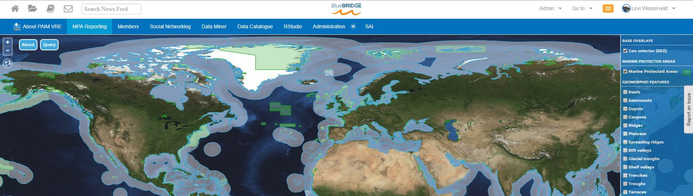
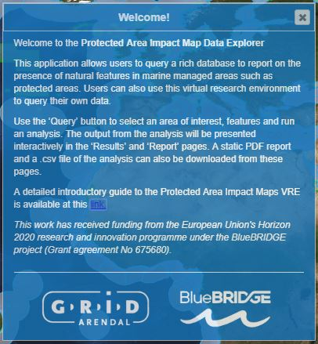
MPA Reporting Portlet – 1.1
The main portlet page is an interactive map where a user can display all the data used by the PAIM VRE.
A small welcome dialogue box briefly explains how to use the portlet.

Slide 31
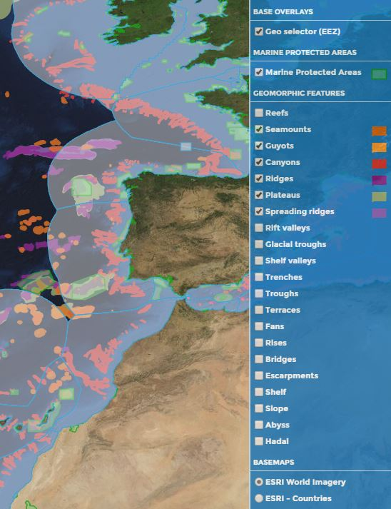
MPA Reporting Portlet – 1.2
On the right hand side, in the home page of the ‘MPA Reporting’ interface, users can turn on/off different data layers.
Features that are turned on will automatically be used in the analysis query by a user.
At the bottom of the layers’ panel, users can also change the basemap between the ESRI World Imagery and the ESRI Countries basemaps.
This page was built using an open source mapping library called ‘OpenLayers’.

Slide 32
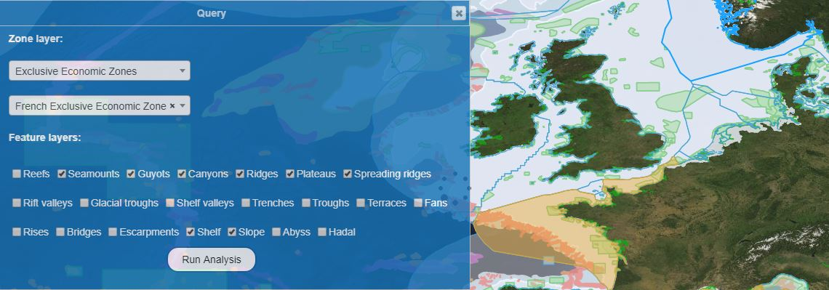
MPA Reporting Portlet – 2
Tap the query box in the top left hand corner of the map viewer to open the query panel. To run a query …
… 1. Select a ‘Zone Layer’ (a zone where the analysis will be performed). This can either be an Exclusive Economic Zone or an Ecoregion. The zone can be selected on the map or using the dropdown menu.
2. Select the Feature Layers to include in the analysis. The features can be selected using either the query box or the layers panel on the right hand side of the map.
3. Click ‘Run Analysis’

Slide 33
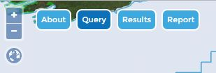
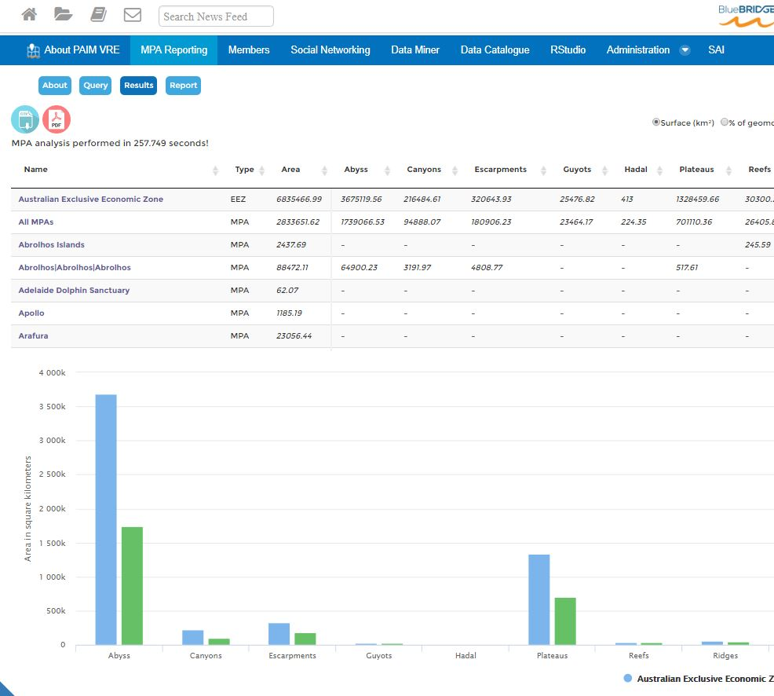
MPA Reporting Portlet – 3
Once an analysis is finished (this could take a few second or minutes!) a new ‘Results’ tab will show in the interface. There you will find…
… 1. an interactive table of the data from the analysis. It shows the real and % values of features in the zone layer and in all the individual MPAs in the zone layer.
2. an interactive chart showing either the real or % values of features in the zone layer versus in all the MPAs combine for that area. This gives users an overview of features present in an EEZ or Ecoregion and how well they are protected.
3. Using the PDF and CSV tabs in the top left hand corner of the interface, users can also download a PDF version of the results page and a CSV file that has all the data generated from the analysis.

Slide 34
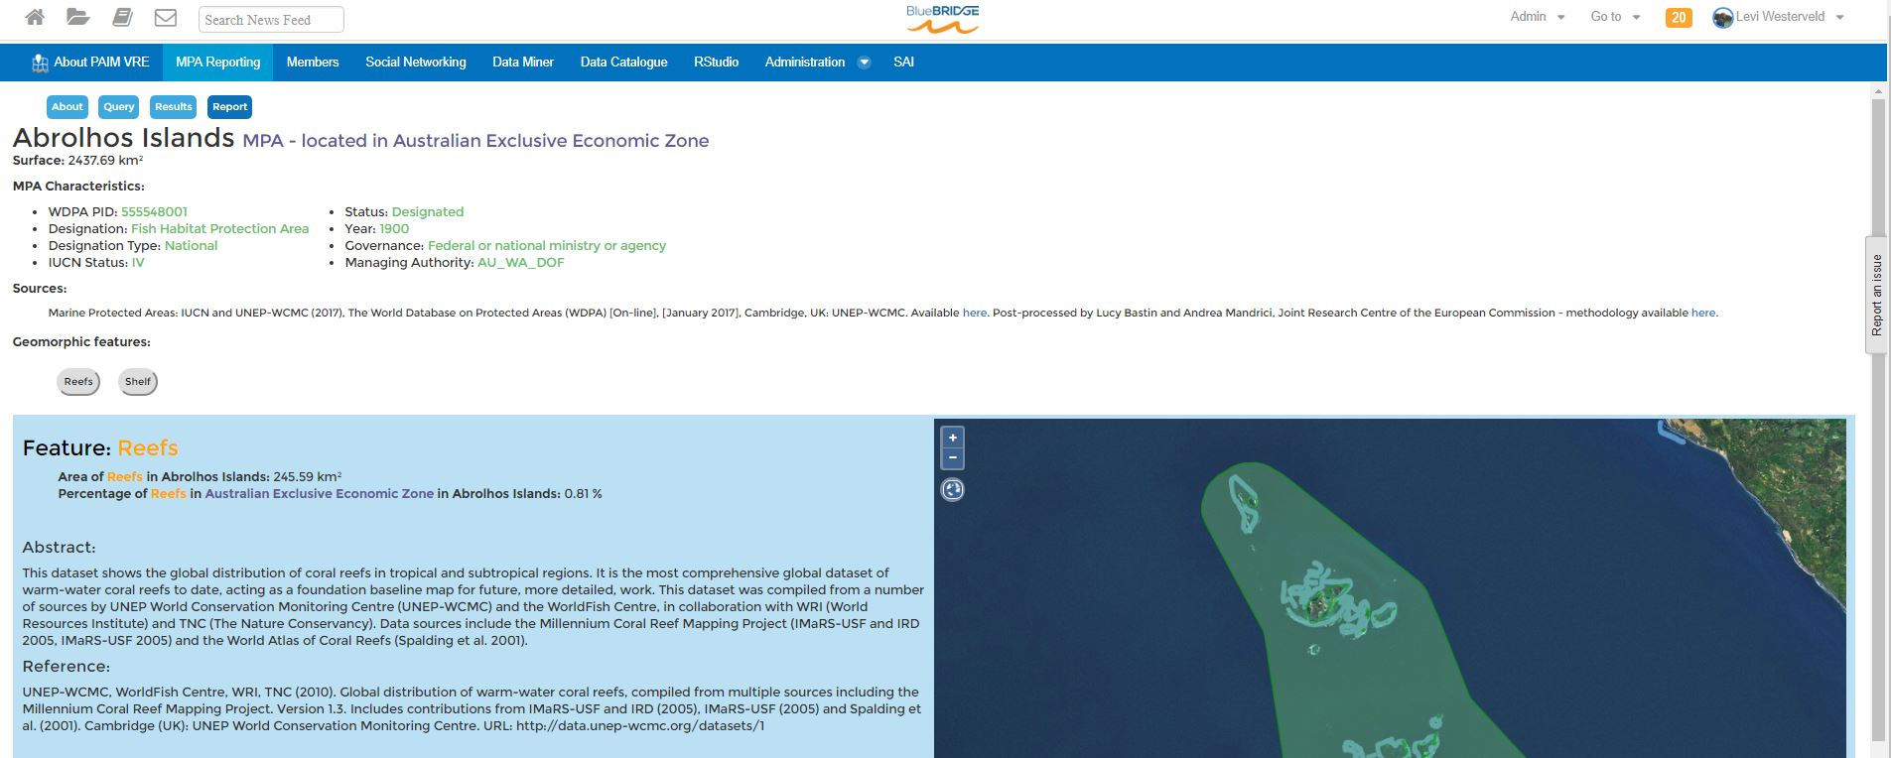
MPA Reporting Portlet – 4
Click on an MPA name in the interactive table to access a detailed report for that MPA (a separate window will open) …
… In the report window for an MPA, extra information for that MPA is provided (ID, designation, IUCN status, year, governance, managing authority, …).
Users are also provided with an abstract and reference information for each feature layer intersecting that MPA. An interactive map on the right hand side shows the specific delimitation of that PA, and the selected feature layer.

Slide 35
Conclusions and Next Steps

Slide 36
The BlueBRIDGE benefits
Collation and access to relevant data and metadata
Rapid processing time - seconds and minutes instead of hours and days!
Repeatability and comparability of processing
Standardised reporting tools
Infrastructure can be accessed by external projects (e.g. JRC BIOPAMA Project)

Slide 37
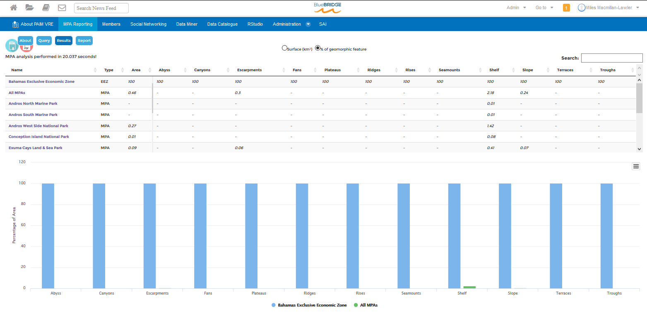
Impact
Countries can report on their protected area networks to determine how well they are representing a standard range of ecologically relevant features (CBD - Aichi target 11)

Slide 38
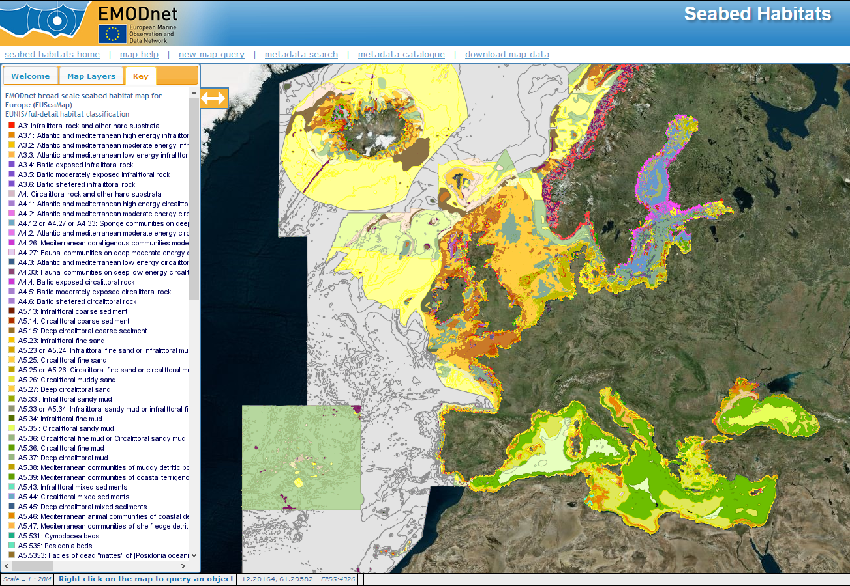
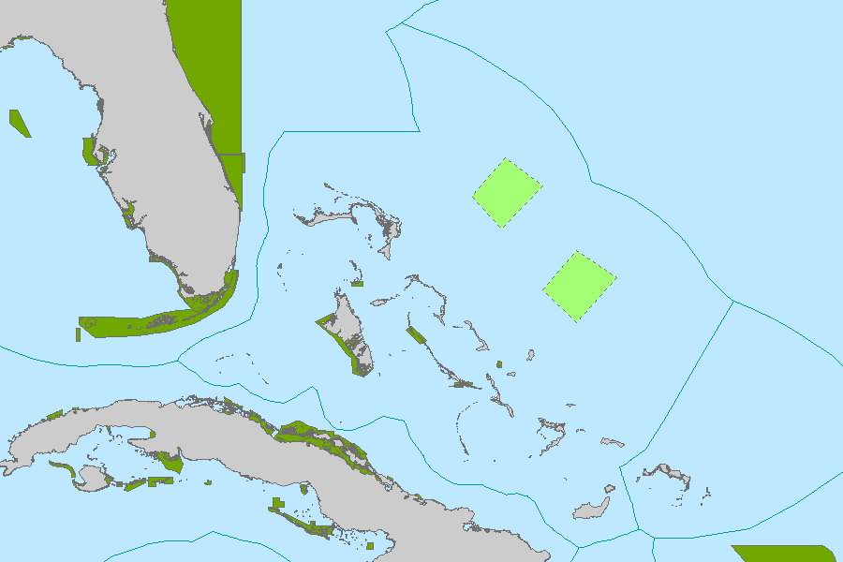
Next steps
Obtain user feedback – improve functionality
Email notification for long processing times
Version of algorithm to include user MPAs and ecological features

Slide 39
Sign Up Today!
https://bluebridge.d4science.org/web/protectedareaimpactmaps
Feedback and suggestions welcome!

