Slide 1
Spade Project Description and Value Proposition
The Spade Project involves the trading/sharing of agricultural data between farmers and the companies with the goal of promoting efficient operations. This data sharing requires the use of a common language among companies and equipment manufacturers.
The Spade Project Team intends to adopt existing standards and if a gap exists, develop standards for the automatic exchange of ag-related data between customers, businesses, and other stakeholders. These standards will promote a seamless, scalable and sustainable producer operation by lowering the barrier for adoption of precision ag products. Agriculture companies will benefit by removing interoperability issues, thereby lowering development costs.
Project Wiki http://wiki.aggateway.org/Spade%20Project.MainPage.ashx
Link to full Charter
http://wiki.aggateway.org/Spade%20Project.Spade_Project_Charter.ashx

Slide 2
Charter Background
The next generation of agricultural managers is asking how the industry can enable seamless data exchange between machines and Farm Management Information Systems (FMIS).
The costs for exchanging data are high due to the lack of common implementation guidelines, data transfer protocols, message standards, and standard reference data.
Producers report that it is difficult or nearly impossible to move data from one system to another.
To do so almost always requires data reentry, manual data transformation, and/or specialists to manage data.
The value chain from manufacturing through distribution supports many data-management, analysis, and decision-support functions for the producer.
Having systems that utilize eBusiness standards and guidelines will help move the industry toward interoperability. This will improve the efficiency and productivity of the producers and their trusted advisors
Historical Work Leading to Charter:
June 2011, the Precision Ag Council’s Field Operations working group identified several industry needs and selected seeding as the example use case to identify applicable standards and analyze gaps within the standards that may be impeding data exchange
At the November 2011 Annual Conference, the team demonstrated a proof of concept regarding message contents for data exchange between software/hardware systems and distributed databases
This charter outlines a project to move from conceptual demonstration to production

Slide 3
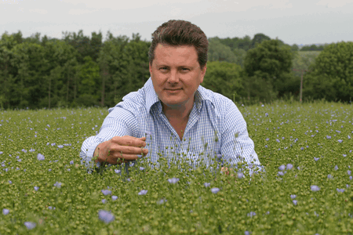
Problem Space Typical Agronomic Data Management Cycle
Agronomist makes recommendation to grower & inputs sourced
Data transferred to agronomist & sent to company GIS specialist
GIS specialists “clean data,” query database, send reports & maps to agronomist
Agronomist analyses data to determine best approach
Prescription downloaded to software & writes to data card
Data transferred to home office
Prescription implemented with machine controller
Data collected by equipment sensors and transferred to GS2 data card
ISO11783

Slide 4
Problem Space Typical Agronomic Data Management Cycle
Agronomic Companies
Agronomist makes recommendation to grower & writes prescription.
Data transferred to agronomist & sent to company GIS specialist
GIS specialists “clean data,” query database, send reports & maps to agronomist
Agronomist analyses data to determine best approach
Producers
Prescription downloaded to software & writes to data card
Data transferred to home office
Prescription implemented with machine controller
Data collected by equipment sensors and transferred to GS2 data card
Equipment Companies

Slide 5
Problem Space Current Data Structure
Agronomic Decision Support
Knowledge of Land/Products Create Value
Public Agronomy Consultants
Crop Protection
Fertilizer manufacturers
Private Agronomy Consultants
Plant breeders
Decision Taking
Interface
Interface
Gathering and Execution
Algorithms Create Value
Technology suppliers
Full line
Manufacturers
Short line
Manufacturers

Slide 6
Problem Space Need for Common Message Structure
Agronomic Solution Providers
Producers
Equipment Manufacturers

Slide 7
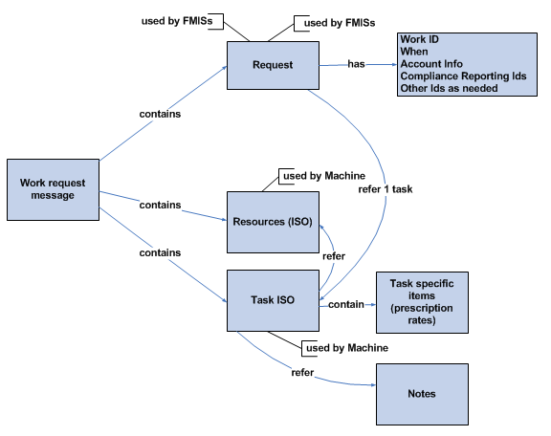
Spade Project Objectives
Standards/Guidelines Development
Understand AgGateway’s standards and guidelines development process. Propose any changes required to meet precision agriculture requirements.
Standards/Guidelines Definition: Identify the process for defining standards
Council Review: Identify mechanics for distribution, review and approval of standards within the PAC.
Submission Process: Identify the process to finalize recommendations for submission into AgGateway formalized (AgExchange - AgE) accepted standards.
AgGateway Member Review Process: Identify the AgGateway cross council review/approval process
Publication: Identify the process to publish online guidelines to the AgGateway community

Slide 8
Message Contents for Review Nov 8, 2011 Mtg
Work Request Message
(FMIS)
ISO XML
(TSK)
ISOXML File
ISOXML may contain
Multiple Operations. Allocates resources that will be used by specific tasks.
Operation Seeding
(CPC, OTQ )
Operation Fertilization
(CPC, OTQ)
Available Resources
Work Request Message
WorkRequest ID
FarmingPractice ID
ISOXML ID(s)
Equipment Devices (DVC)
Product (PDT
Commodity (CTP)
Rx
(TZN, GRD)
Resources Assigned to TSK
(may have attachment files - XFR)
Boundary (PFD)
Labor (WKR)
ISO XML
Farming Practice: Templates assigned by FMIS to refer to a practice or series of operations (could include USDA, NRCS, EPA, etc.). Not part of ISO11783 and used by FMIS only.
Uses ISO11783 by FMIS and Controller
Notes
Currently there are several optional ISO elements. We recommend they be required for AgGateway data exchange.
ISO Cultural Practice (CPC) – Describes cultural practices that can be allocated to a task “Seeding”, “Fertilization”
ISO Operation Technique (OTQ) – Describes technique like “Drilling”, “Seeding”
ISO Crop Type (CTP) – Potential to reference coded list from agency versioned list (USDA published in clearinghouse)

Slide 9
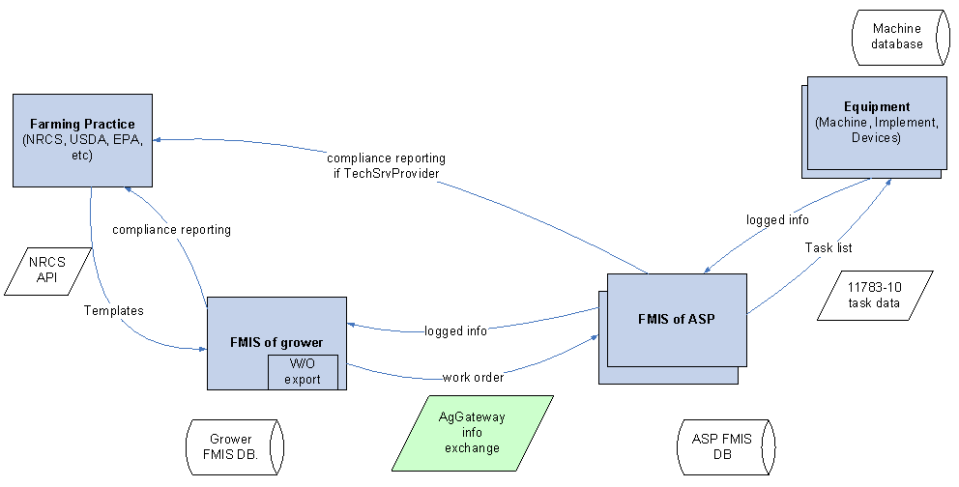
Spade Project Objectives
Standards/Guidelines Development
Understand AgGateway’s standards and guidelines development process. Propose any changes required to meet precision agriculture requirements.
Standards/Guidelines Definition: Identify the process for defining standards
Council Review: Identify mechanics for distribution, review and approval of standards within the PAC.
Submission Process: Identify the process to finalize recommendations for submission into AgGateway formalized (AgExchange - AgE) accepted standards.
AgGateway Member Review Process: Identify the AgGateway cross council review/approval process
Publication: Identify the process to publish online guidelines to the AgGateway community
Production Demonstration - Seeding Use Case: Outline process of defining standards using the seeding use case example
Field Ops 2011 Example - Problem Space

Slide 10
Spade Project Objectives
Standards/Guidelines Development
Understand AgGateway’s standards and guidelines development process. Propose any changes required to meet precision agriculture requirements.
Standards/Guidelines Definition: Identify the process for defining standards
Council Review: Identify mechanics for distribution, review and approval of standards within the PAC.
Submission Process: Identify the process to finalize recommendations for submission into AgGateway formalized (AgExchange - AgE) accepted standards.
AgGateway Member Review Process: Identify the AgGateway cross council review/approval process
Publication: Identify the process to publish online guidelines to the AgGateway community
Production Demonstration - Seeding Use Case: Outline process of defining standards using the seeding use case example
Other Field Operations: Outline use cases for progressing with other operations (seeding, spraying, fertilizing, etc) and consider opportunities for promoting more widespread adoption.
Future Project Approach: Develop project documentation
Define API’s required to share reference data from distributed databases and/or the AGIIS directory.
Define the guidelines for implementation of the API’s.
Ensure scalability of the implementations for all size participants

Slide 11
Spade Project Deliverables
Delieverables
Use case definitions for major production practices including but not limited to seeding, tillage, spraying, fertilizing, harvesting
Implementation guidelines for data exchange message use cases and including the required components
Documentation of the API’s required to share reference data (primarily product identifiers but also base data like soils, production practices, etc.), from the manufacturer database (product owner) and the systems using the data
Demonstration of the data exchange messaging and reference data from distributed databases
Recommendation(s) to the AGIIS Directory Oversight Committee for utilization of the AGIIS directory and the management of standardized API’s
Recommendation(s) for development and implementation of the reference data sharing model API and clearinghouse concept
Estimated Time: March 2012-December 2012
Estimated Cost: $80,000

